Slide 1
How to Create an FSA ID
RMHS Counseling
2022-2023

Slide 2
CALIFORNIACOLLEGES.EDU
Log into CCGI (Californiacolleges.edu). If you do not have an account or need to have your CCGI password reset - Sign the CCGI Password Reset Sheet.
Your counselor will reset it for you and you will receive an email with instructions on how to “reset your password”.
You will need to have your CCGI account fully activated to do submit your FAFSA

Slide 3
What will we be covering today?
What is financial aid?
What is the financial aid process?
What documents will I need?
College Kick Off Worksheet

Slide 4
What is Financial Aid?
Financial Assistance that can help you pay for some or most of your college expenses
Tuition
Books
Transportation
Room and Board

Slide 5
Who needs to apply for Financial Aid?
EVERYONE -
What are your beliefs about financial aid, what have you heard?

Slide 6
Step 1: Create FSA ID
fsaid.ed.gov
Used to electronically sign your FAFSA
Create a FSA ID for 1 of your parents (they must have a SSN) & 1 for you!
Write down the FSA ID and don’t share it
If you do not have SSN or parent does not, DO NOT create an FSA ID!
If YOU have no SSN, begin working on Dream Act Application (CADAA) at https://caldreamact.org

Slide 7
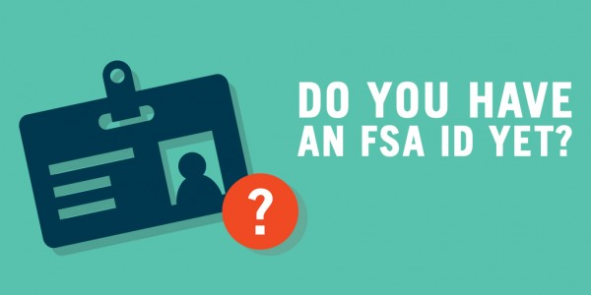
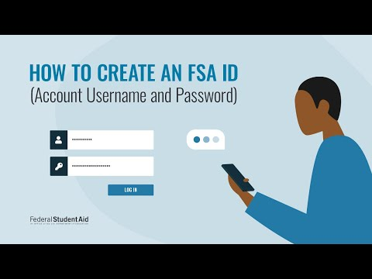
FSA ID Video
Notes:
https://www.youtube.com/watch?v=-_TxX0-yuuA

Slide 8
Tips for FSA ID
Do not use your school email address use your private one.
Do not put your email address down as your parents; if your parents do not have an email account create one for them
Make sure your name matches exactly the same as it is written on your social security card.
Double check information is written correctly.

Slide 9
Create Your FSA ID

Slide 10
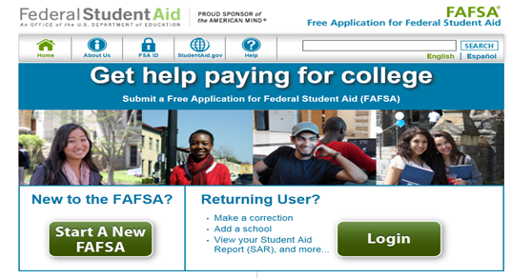
Step 2: Complete an Application
Once you have completed and verified your FSA ID and created an FSA ID for one of your parents (or received information from older sibling), you can now begin your FAFSA for 2022-2023 school year!!!
This is what we will be doing during College Kick-Off Week in OCTOBER!
www.fafsa.gov

Slide 11
Important Information for College & Career Day
College and Career Kick-off is on Wednesday, October 12, 2022
Time: 8:45am- 1:40pm
Bring your FSA ID Username & Password
Bring your parents FSA ID Username & Password
Bring your Chromebook fully charged & Chromebook Charger
College Kick Off Worksheet completed to the best of your ability
CCGI- Username & password

Slide 12
Thank You!
We are here to help and support you!
Please request an appointment with your counselor if you have any questions or concerns.

