Slide 1
2024-25 Course Selection Presentation

Slide 2
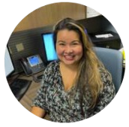
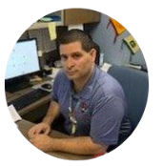
RMHS COUNSELING DEPARTMENT
Mrs. Garcia
DiB - Long
RACE Academy, TTECHS,
Advanced Theater, SMART Program
9th Grade Special Education
Mr. Solis
Ramos - Z
CAFE Academy
11th Grade Special Education
Ms. Huynh
A - Diaz Santiago
AVID Program
12th Grade Special Education
Ms. Watson
Lopez - Ramirez
Advanced Performing Arts
10th Grade Special Education

Slide 3
GRADUATION REQUIREMENTS
PSUSD Graduation Requirement
225 Total
1.51 Minimum GPA
Pass IM I or equivalent
Minimum Credits at the end of 9th Grade Year – 45 Credits
1 class = 10 credits per year
Or 5 credits per semester.
Students take 6 class and can earn 60 credits in one year.

Slide 4
A-G Requirements
class | Subject | Years | Credits
A | History | 2 years | 20
B | English | 4 years | 40
C | Math | 3⁺ years | 30
D | Science (Life & Physical) | 2⁺ years | 20
E | Language other than English | 2⁺ years | 20
F | Visual/Performing Arts | 1⁺ year | 10
G | College Prep Elective | 1 year | 10
All grades must be a C or better! |  |  | 150 credits
HS Graduation credit requirement
History: 30
English: 40
Math: 30
Science 20
LOTE: 10 or
VAPA: 10
PE: 20
Electives: 75 credits
225 credits

Slide 5
OPTIONS FOR SENIOR YEAR
College of the Desert Concurrent Enrollment
What is Concurrent Enrollment?
The concurrent enrollment program provides an opportunity for high school students to earn college credits at College of the Desert (COD) before completing their high school diploma.
Concurrent enrollment are classes taken outside of the regular school day
What is the criteria to apply for the concurrent enrollment?
Must be enrolled in high school
Must have a cumulative GPA of 3.0 or higher (If your GPA is below 3.0, a letter of recommendation from a teacher or counselor is required).

Slide 6
COLLEGE OF THE DESERT
What are the charges for concurrent enrollment?
Tuition and fees are free to high school students. High school students only need to purchase books, supplies, and a parking permit, if needed.
How do I sign-up for courses?
Concurrent Enrollment Complete Checklist
Review the class schedule with your high school counselor and select a course.
Student can take up to 11 credits (fall and spring), 6 credits (summer), or 1 course (winter).
All courses must be approved by the college.
Remember, for every one hour of lecture or lab, two hours of homework will be expected.
Before starting concurrent enrollment, please contact your counselor FIRST!
Notes:
https://www.collegeofthedesert.edu/students/admissions/high-school.php

Slide 7
CLASSROOM/OFFICE AIDE APPLICATION
Ed Code 51228.1 school districts may assign students as teachers/office assistants and tutors only if the following conditions are met:
The school officials determine that the student will benefit from the placement and
The parent gives consent in writing to the student being placed as a teacher’s assistant or office assistant.

Slide 8
CLASSROOM/OFFICE AIDE APPLICATION
To earn credit, the following procedures are necessary
Classroom/Office assistants or Academic/Bilingual tutors are assigned to certificated staff that will be responsible for reporting attendance and giving a grade for credit.
Assistants and tutors are supervised by the certificated staff member.
Student assistants and tutors should be on track to meet graduation requirements and all ramifications of being placed as an assistant has been fully explained to the student and parents. Being an aide is not included in the “a-g” completion, and academic content courses take priority.

Slide 9
EARLY RELEASE/LATE START AGREEMENT
Ed Code 51226.1 school districts may allow students to apply for an early release/late start only if the following conditions are met:
The school officials determine that the student will benefit from the early release.
The parent gives consent in writing to the student being release early or starting later each day.
Every secondary school student in Palm Springs USD is required to attend a full day schedule per Ed Code 46100. Only seniors who meet the following criteria will be allowed to apply for an early release/late start.
If approved, only one period are you allowed to be unscheduled, 1st or 6th

Slide 10
EARLY RELEASE/LATE START AGREEMENT
con’t
Students have been counseled about options for a shortened day (community college, employment, internship, etc.)
The student has an overall grade point average of 2.0 or higher.
Student is on track to meet graduation requirements & current with your A-G Requirements by the end of his/her senior year.
The shortened day is being requested by the student AND parent.

Slide 11
ENGLISH COURSE FOR 2024-25 ACADEMIC YEAR
ETHNIC LITERATURE & STUDIES
Length of Course: 1 Year
Grades: 12 Prerequisites: English III
Credits: 10
Type: Requirement
Generally, the course will cover the concepts of race and ethnicity, culture, critical race theory, intersectionality, and literary devices. The major focus will be for students to apply the unique aspects of each unit to multiple ethnic literatures to build connections and appreciations for cultures similar and unlike their own.

Slide 13
SENIOR CLASS FOR 2024-25 ACADEMIC YEAR
SENIOR SEMINAR
Length of Course: 1 Semester
Grades: 12
Prerequisites: None, paired with Personal Finance
Credits: 5
In this course, students will complete several tasks to prepare them for graduation and their 5-year plan. Students will complete college applications using CCGI for the CSU, FAFSA/ Dream Act, and UC applications. They will also receive assistance with the Common Application, Black Common Application, College of the Desert EDGE/PLEDGE as well as private school applications. Students entering the workforce out of high school will receive help with career surveys, job searches, and completing job applications. Students will also finalize a Scholarship Packet, resume, personal statement, and/or cover letter.

Slide 14
SENIOR CLASS FOR 2024-25 ACADEMIC YEAR
PERSONAL FINANCE
Length of Course: 1 Semester
Grades: 12 Prerequisites: None, paired with Senior Seminar
Credits: 5
Personal Finance is a semester-long course designed to deliver essential financial understanding engagingly. Students will learn personal finance through comprehensive lesson plans, activities, projects, and more. The curriculum is also designed to use current technology, spark participation, and integrate real-world scenarios. Personal Finance consists of 10 units and diagnostic, midterm, and final exams that expand upon a student’s finance, math, and critical thinking skills.

Slide 15
SEMESTER 2 – PERSONAL FINANCE THE MONEY CLASS $$$
Learn how to save, manage money, & build wealth
How to build credit
How to buy a car
How to buy a house
Budgeting
Investing in the stock market
Learn about the psychology of money
The habits of Millionaires

Slide 16
EXISTING COURSES
COMPUTER SCIENCE A - ADVANCED PLACEMENT
Length of Course: 1 Year
Grades: 11-12 Prerequisites: IM I recommended
Credits: 10
Type: Elective (G & C)
AP Computer Science A is an introductory college-level computer science course. Students cultivate their understanding of coding through analyzing, writing, and testing code as they explore concepts like modularity, variables, and control structures.

Slide 17
EXISTING COURSES
COMPUTER SCIENCE PRINCIPLES - ADVANCED PLACEMENT
Length of Course: 1 Year
Grades: 10-12
Prerequisites: Integrated Math I recommended
Credits: 10
Type: Elective (G & D)
AP Computer Science Principles is an introductory college-level computing course that introduces students to the breadth of the field of computer science. Students learn to design and evaluate solutions and apply computer science to solve problems through the development of algorithms and programs. They incorporate abstraction into programs and use data to discover new knowledge. Students also explain how computing innovations and computing systems—including the internetwork, explore their potential impacts and contribute to a computing culture that is collaborative and ethical.

Slide 18
EXISTING COURSES
Human Geography - ADVANCED PLACEMENT
Length of Course: 1 Year
Grades: 9-12
Prerequisites: None
Credits: 10
Type: Elective (A & G)
AP Human Geography is an introductory college-level human geography course. Students cultivate their understanding of human geography through data and geographic analyses as they explore topics like patterns and spatial organization, human impacts and interactions with their environment, and spatial processes and societal change.

Slide 19
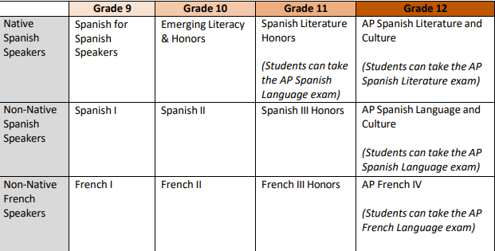
WORLD LANG SEQUENCE – NATIVE/NON-NATIVE

Slide 20
CA STATE SEAL OF BILITERACY
In order to fulfill the CA State Seal of Biliteracy you must meet the
English criteria & demonstrate proficiency in another language other than English.

Slide 21
CA STATE SEAL OF BILITERACY
Meeting the English criteria includes:
Completion of all FOUR years of English language arts requirements for graduation with an overall grade point average of 3.0 or above.
OR
Passing the California Standards test (CAASPP) in English language arts administered in grade 11th at the proficient level or above.
Pass an Engl. AP examination w/a score of 3 or higher (AP Lang. or AP Lit.)
English language learners who have not been reclassified, must attain the overall “early advanced level” on the English language development test (ELPAC).

Slide 22
CA STATE SEAL OF BILITERACY
Meeting the criteria for proficiency in a language other than English requires one of the following:
Successful completion of a 4-yr high school course of study in a world language (LOTE) and attaining an overall grade point average of 3.0 or above.
OR
Passing a World Language Advanced Placement (AP) exam with a score of 3 or higher.
AP Span. Lit. IV
AP Span. Lang. IV
AP French IV

Slide 23
AP/HONORS CONTRACT
EXPECTATIONS:
Remain in the AP/Honors course that I have requested for the entire school year.
Take the AP Exam (if applicable) in the Spring 2026
Maintain high ethical standards concerning academic involvement, growth, and development.
Complete all assigned reading, homework, labs, research projects – including any summer homework.
Maintain regular class attendance.
Low grades will NOT be considered a reason for removal from AP/Honors courses, so commitment and progress for all students is the expected standard.
Speak with your AP/Honors teacher(s) regarding any problems or concerns you have regarding your success. OWN IT!!!

Slide 24
HOW TO RETAKE OR RECOVER A GRADE
Edgenuity (online) classes are available during the school day as well as during 0 period. Zero period class attendance is mandatory M, T, Th & F (Media Center). Priority is given to those seniors needing the credits for graduation.
Students enrolling in the 0 period Edgenuity class must complete the course within the quarter (Q1, Q2, Q3 & Q4). A letter grade will be given.
Attend summer school at RMHS or seek other options, for example, Mirus Charter School (Online classes), etc.

Slide 25
CLASS OF 2025 COURSE REGISTRATION
Class of 2025 course registration will take place through Social Studies classes on the following dates.
Thursday, February 8, 2024 (Auxiliary Gym) or
Friday, February 9, 2024 (Auxiliary Gym)
You will submit:
Completed Course Selection form signed by a parent/guardian
You will receive:
Transcript
Classroom/Office Aide Application
Early Release/Late Start Application

Slide 26
RMHS COUNSELING DEPT WEBSITE
Rancho Mirage High School
www.rmhs.us
Counseling – Course Request Information
https://www.rmhs.us/course-request-information1.html
Rancho Mirage High School 2024-25 Course Catalog
https://www.rmhs.us/uploads/1/4/5/4/145415380/rmhs_course_catalog_24-25.pdf

Slide 27
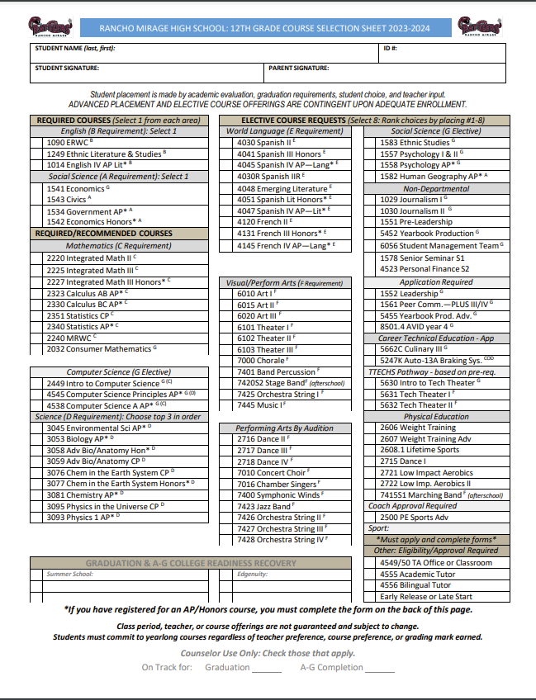

Slide 32
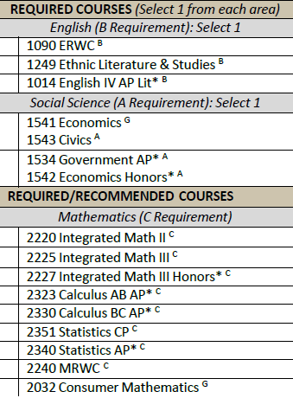

Slide 33
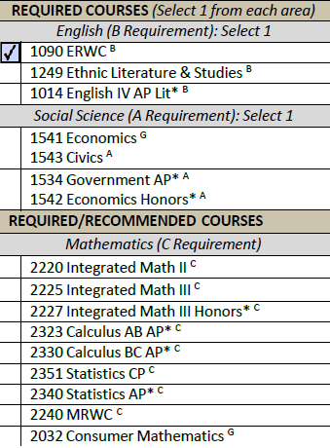

Slide 34
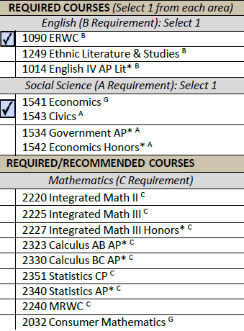

Slide 35
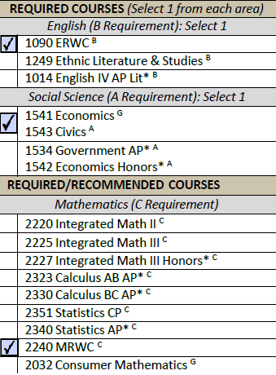

Slide 36
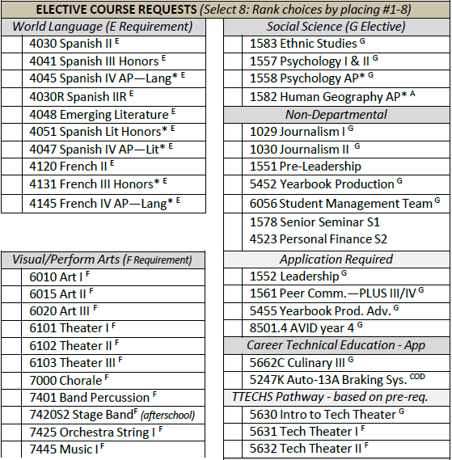
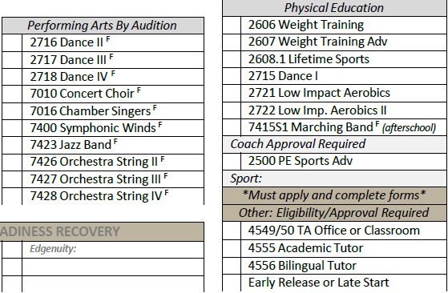

Slide 37
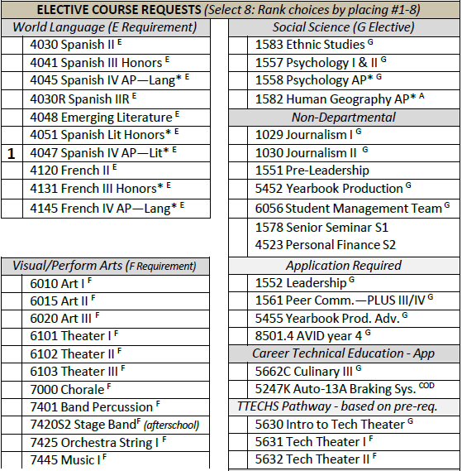

Slide 39
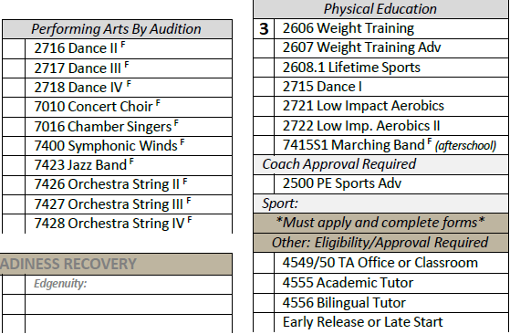

Slide 40
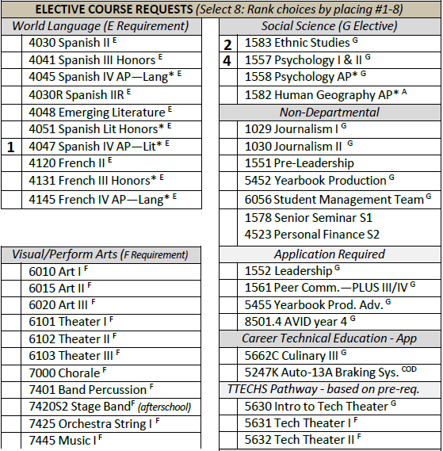

Slide 41
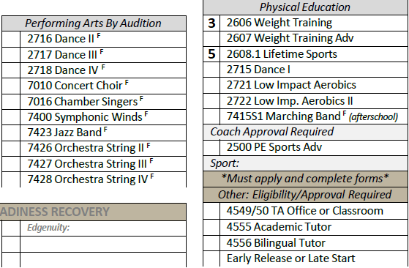

Slide 43
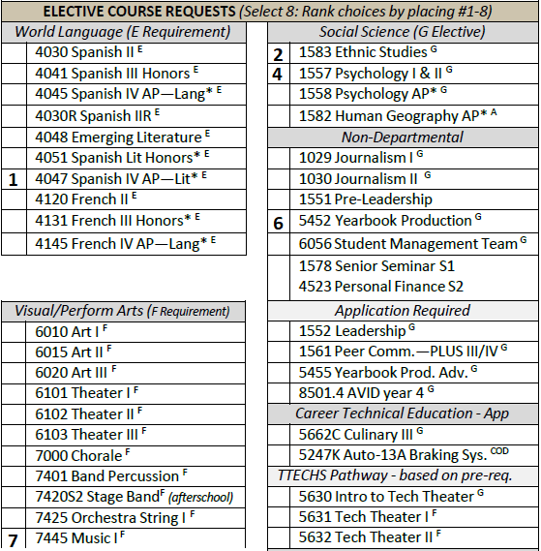

Slide 44
