Slide 1
2024-25 Course Selection Presentation

Slide 2
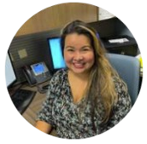
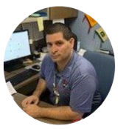
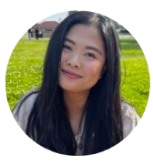
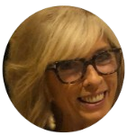
RMHS COUNSELING DEPARTMENT
Mrs. Garcia
DiB - Long
RACE Academy, TTECHS,
Advanced Theater, SMART Program
9th Grade Special Education
Mr. Solis
Ramos - Z
CAFE Academy
11th Grade Special Education
Ms. Huynh
A - Diaz Santiago
AVID Program
12th Grade Special Education
Ms. Watson
Lopez - Ramirez
Advanced Performing Arts
10th Grade Special Education

Slide 3
GRADUATION REQUIREMENTS
PSUSD Graduation Requirement
225 Total
1.51 Minimum GPA
Pass IM I or equivalent
Minimum Credits at the end of 9th Grade Year – 45 Credits
1 class = 10 credits per year
Or 5 credits per semester.
Students take 6 class and can earn 60 credits in one year.

Slide 4
A-G Requirements
class | Subject | Years | Credits
A | History | 2 years | 20
B | English | 4 years | 40
C | Math | 3⁺ years | 30
D | Science (Life & Physical) | 2⁺ years | 20
E | Language other than English | 2⁺ years | 20
F | Visual/Performing Arts | 1⁺ year | 10
G | College Prep Elective | 1 year | 10
All grades must be a C or better! |  |  | 150 credits
HS Graduation credit requirement
History: 30
English: 40
Math: 30
Science 20
LOTE: 10 or
VAPA: 10
PE: 20
Electives: 75 credits
225 credits

Slide 5
OPTIONS FOR JUNIOR YEAR
AVID (Advancement Via Individual Determination) Program. Application & Interview process
VAPA (Visual Arts & Performing Arts ) Program
Theater/Technical Pathway
Student Management Team
Journalism I & Yearbook Production

Slide 6
AVID PROGRAM
This well-known program is available for students who seek support to learn more about college and career options in order to best prepare for post-secondary education and beyond. This program focuses on WICOR strategies, study habits, time management, organization, and college exploration. Students are able to visit college campuses and explore careers based on various degrees.
Student must complete an AVID application online @ ranchomiragehighschool.org/course-request-information.
Applicants will be invited to an interview conducted by the AVID team
Applicants will be notified if they were accepted by the AVID team
AVID application due by Friday, February 16th

Slide 7
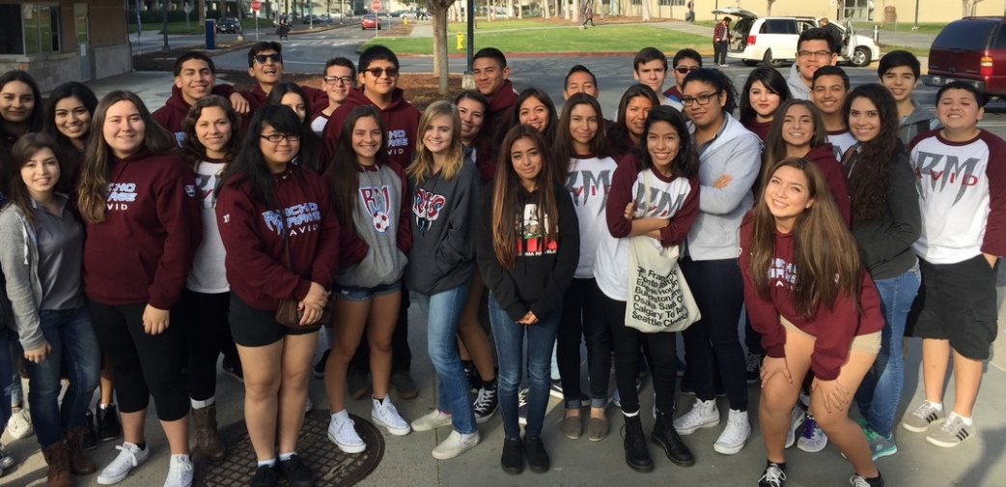
avidrmhs.weebly.com

Slide 8
OPTIONS FOR JUNIOR YEAR
College of the Desert Concurrent Enrollment
What is Concurrent Enrollment?
The concurrent enrollment program provides an opportunity for high school students to earn college credits at College of the Desert (COD) before completing their high school diploma.
Concurrent enrollment are classes taken outside of the regular school day
What is the criteria to apply for the concurrent enrollment?
Must be enrolled in high school
Must have a cumulative GPA of 3.0 or higher (If your GPA is below 3.0, a letter of recommendation from a teacher or counselor is required).

Slide 9
COLLEGE OF THE DESERT
What are the charges for concurrent enrollment?
Tuition and fees are free to high school students. High school students only need to purchase books, supplies, and a parking permit, if needed.
How do I sign-up for courses?
Concurrent Enrollment Complete Checklist
Review the class schedule with your high school counselor and select a course.
Student can take up to 11 credits (fall and spring), 6 credits (summer), or 1 course (winter).
All courses must be approved by the college.
Remember, for every one hour of lecture or lab, two hours of homework will be expected.
Before starting concurrent enrollment,
please contact your counselor FIRST!
Notes:
https://www.collegeofthedesert.edu/students/admissions/high-school.php

Slide 10
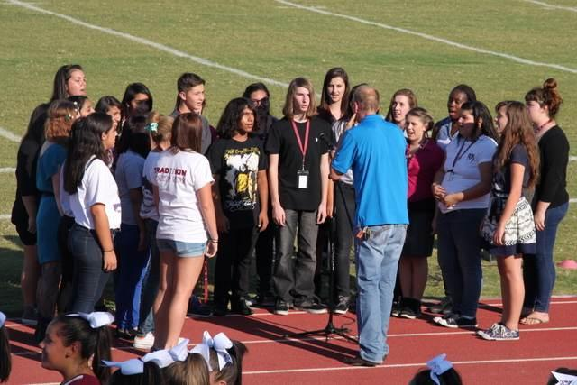
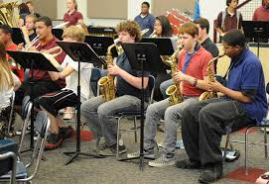
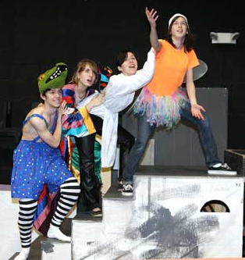
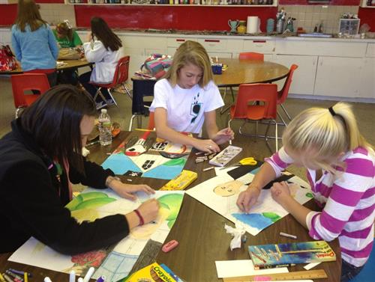
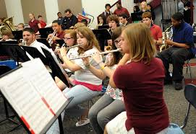
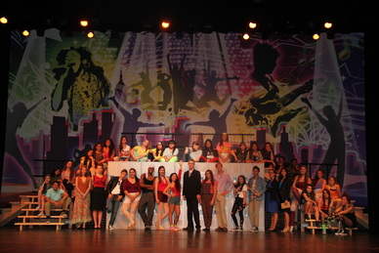
VISUAL / PERFORMING ARTS
Band
Choir
Yearbook
Dance
Theater
Art

Slide 11
THEATER/TECHNICAL PATHWAY
This newer pathway focuses on the variety of technical fields in the performing arts such as stagecraft, lighting, sound, costume design, set design, and business management. These lucrative jobs are in high demand in California, and RMHS is poised to prepare students to successfully enter this job market. Students complete a sequence of CTE courses, as well as a rigorous course of study in the core academic areas.

Slide 12
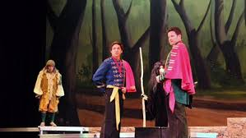
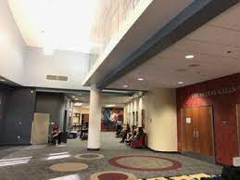
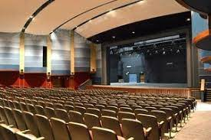
STUDENT MANAGEMENT TEAM
Separate from the Technical Theater Pathway sequence is the new Student Management Team course (SMT). Students learn about the box office, business management, and marketing. Ticket sales, advertising, and ushering are key components to running the Helene Galen Performing Arts Center (HGPAC) where students are able to gain practical, hands-on knowledge of managing a theater.

Slide 13
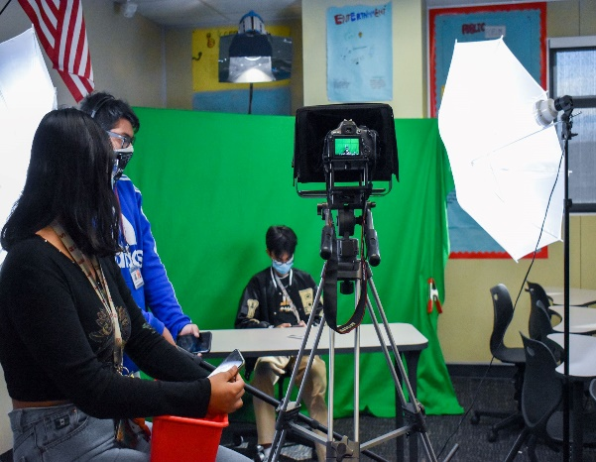
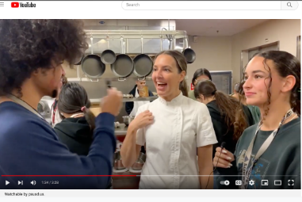
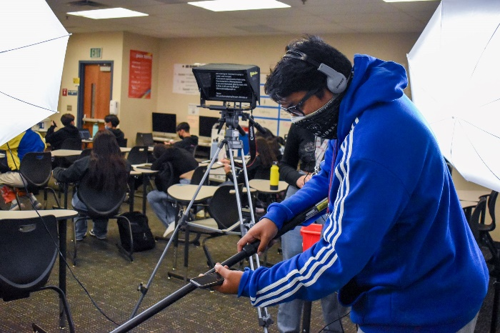
JOURNALISM I
Introduction to Digital Storytelling
Learn Video & Film Production;
Prepare segments for the Rattler Report broadcast;
Explore Podcasting, Filmmaking, Digital Animation;
Work in Adobe Premiere Pro, Animator, Illustrator, & After Effects;
Enter Short Film contests.
(most similar to DATA at CCHS or FILM at PSHS)

Slide 14
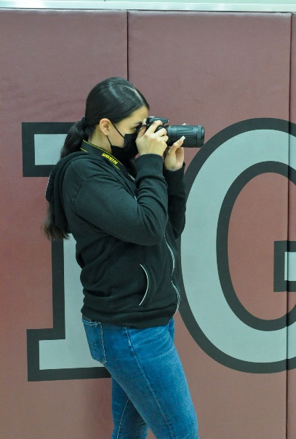
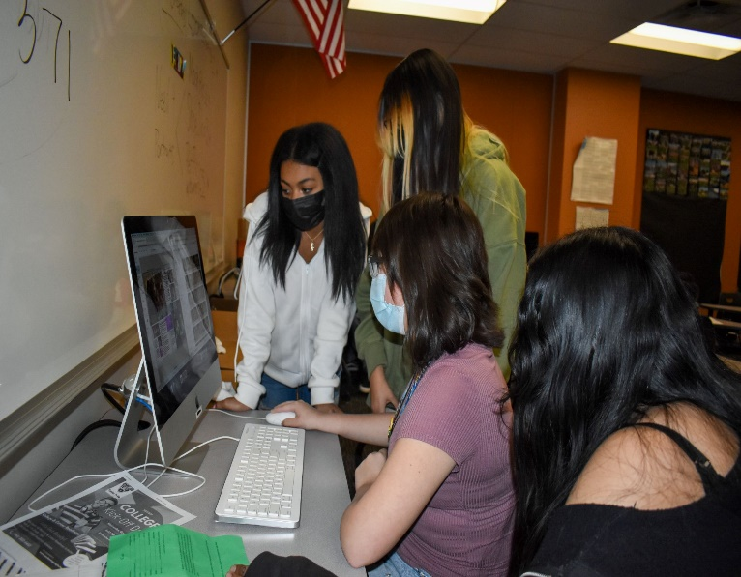
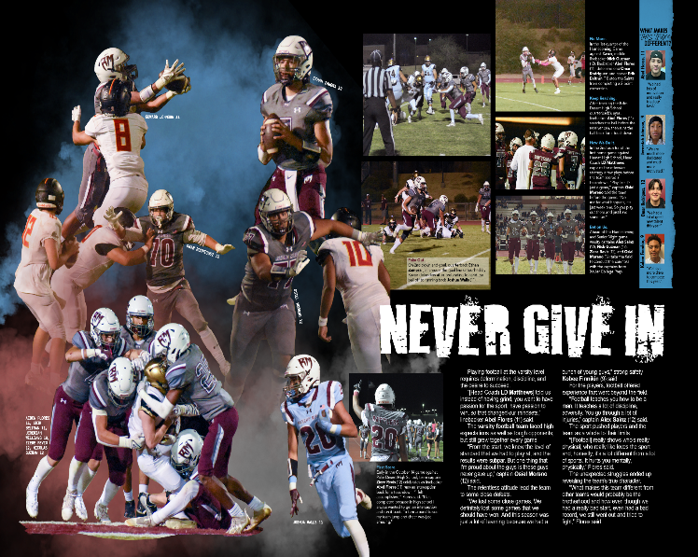
YEARBOOK PRODUCTION
Document RMHS’ History
Produce the yearbook for 2024-25;
Learn Photography skills both journalistic and artistic;
Learn graphic design skills;
Have your writing PUBLISHED, tell the stories people will read forever;
Work in Adobe Photoshop and Lightroom;
Enter national contests to win awards for your work.

Slide 15
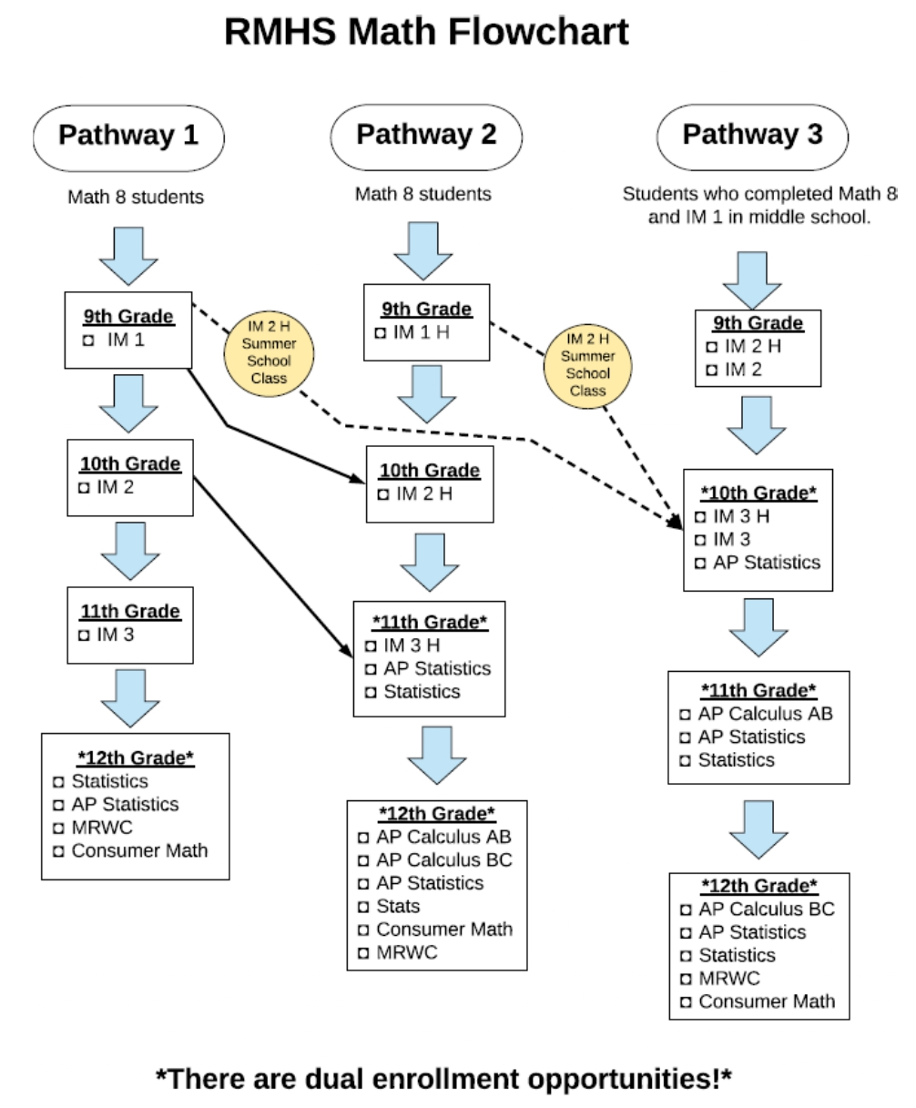

Slide 16
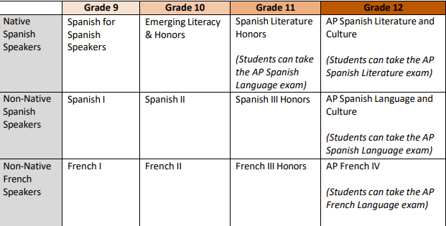
WORLD LANG SEQUENCE – NATIVE/NON-NATIVE

Slide 17
CA STATE SEAL OF BILITERACY
In order to fulfill the CA State Seal of Biliteracy you must meet the
English criteria & demonstrate proficiency in another language other than English.

Slide 18
CA STATE SEAL OF BILITERACY
Meeting the English criteria includes:
Completion of all FOUR years of English language arts requirements for graduation with an overall grade point average of 3.0 or above.
OR
Passing the California Standards test (CAASPP) in English language arts administered in grade 11th at the proficient level or above.
Pass an Engl. AP examination w/a score of 3 or higher (AP Lang. or AP Lit.)
English language learners who have not been reclassified, must attain the overall “early advanced level” on the English language development test (ELPAC).

Slide 19
CA STATE SEAL OF BILITERACY
Meeting the criteria for proficiency in a language other than English requires one of the following:
Successful completion of a 4-yr high school course of study in a world language (LOTE) and attaining an overall grade point average of 3.0 or above.
OR
Passing a World Language Advanced Placement (AP) exam with a score of 3 or higher.
AP Span. Lit. IV
AP Span. Lang. IV
AP French IV

Slide 20
HOW TO RETAKE OR RECOVER A GRADE
Edgenuity (online) classes are available during the school day as well as during 0 period. Zero period class attendance is mandatory M, T, Th & F (Media Center). Priority is given to those seniors needing the credits for graduation.
Students enrolling in the 0 period Edgenuity class must complete the course within the quarter (Q1, Q2, Q3 & Q4). A letter grade will be given.
Attend summer school at RMHS or seek other options, for example, Mirus Charter School (Online classes), etc.

Slide 21
AP/HONORS CONTRACT
I will:
Remain in the AP/Honors course that I have requested for the entire school year.
Take the AP Exam (if applicable) in the spring of 2024
Maintain high ethical standards concerning academic involvement, growth, and development.
Complete all assigned reading, homework, labs, research projects – including any summer homework.
👉🏼 Low grades will NOT be considered a reason for removal from AP/Honors courses, so commitment and progress for all students is the expected standard.

Slide 22
AP/HONORS CONTRACT
con’t
Maintain regular class attendance.
Speak with your AP/Honors teacher(s) regarding any problems or concerns you have regarding your success. OWN IT RATTLERS…!!!

Slide 23
CLASS OF 2026 COURSE REGISTRATION
Class of 2026 course registration will take place through Social Studies classes on the following dates.
Monday, February 12, 2024 (Auxiliary Gym) or
Tuesday, February 13, 2024 (Auxiliary Gym)
You will submit:
Completed Course Selection form signed by a parent/guardian
You will receive:
Transcript
Summer school information

Slide 24
RMHS COUNSELING DEPT WEBSITE
Rancho Mirage High School
www.rmhs.us
Counseling – Course Request Information
https://www.rmhs.us/course-request-information1.html
Rancho Mirage High School 2024-25 Course Catalog
https://www.rmhs.us/uploads/1/4/5/4/145415380/rmhs_course_catalog_24-25.pdf

Slide 25
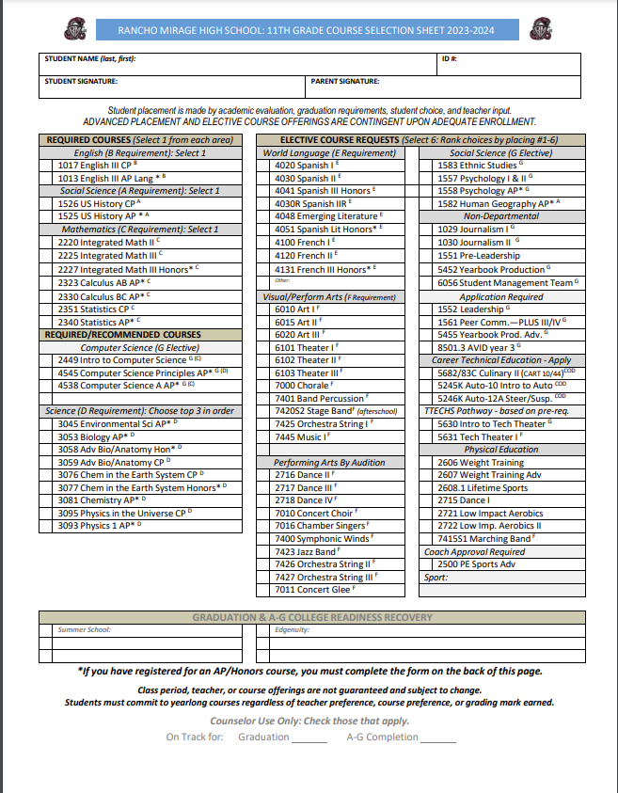

Slide 30
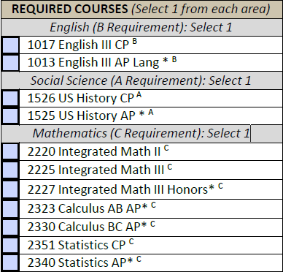

Slide 31
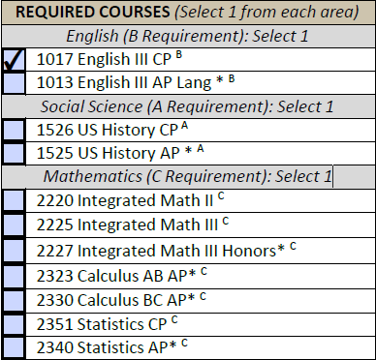

Slide 32
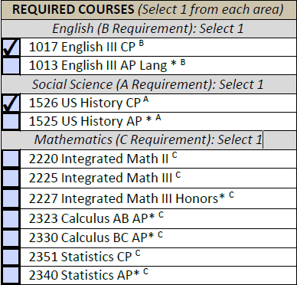

Slide 33
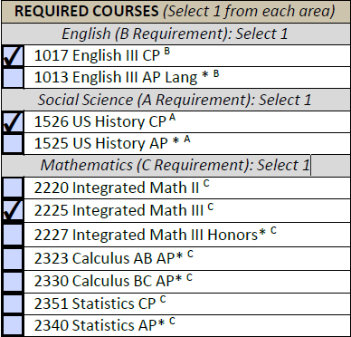

Slide 34
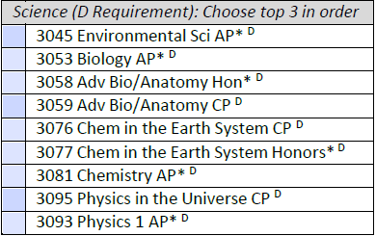

Slide 35
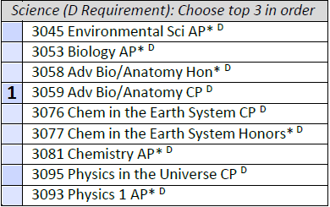

Slide 36
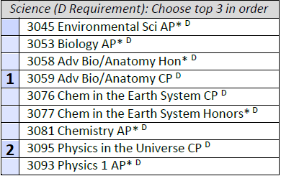

Slide 37
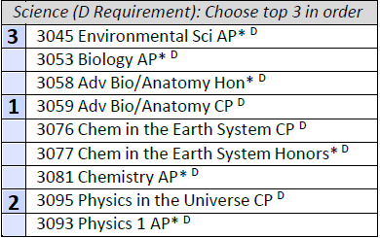

Slide 38
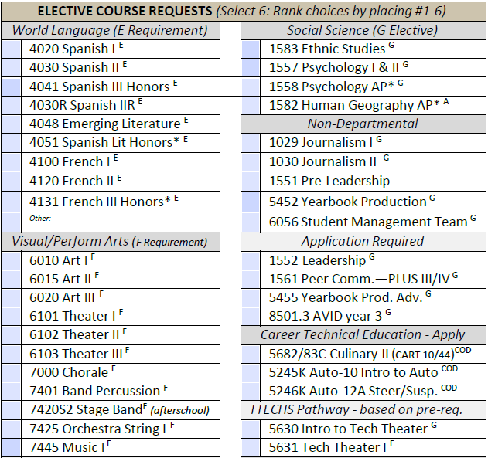
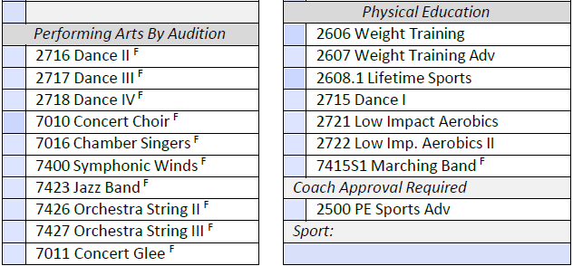

Slide 41
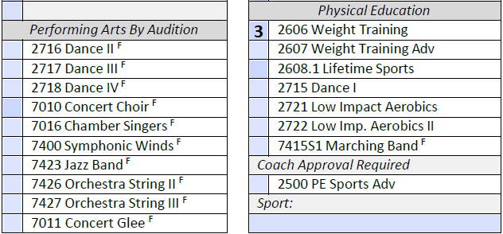

Slide 43
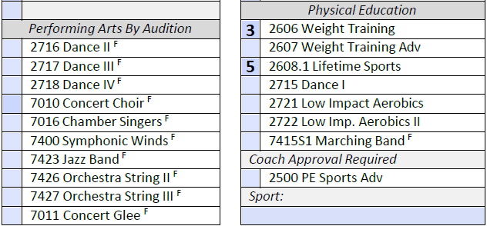

Slide 45
