Slide 1

2023-24 Course Selection Presentation

Slide 2
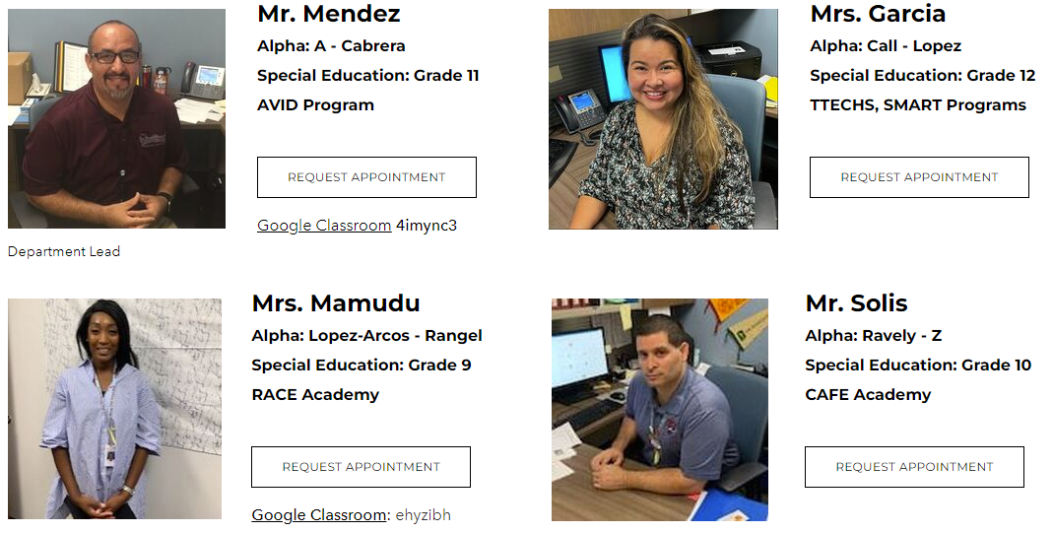

RMHS Counseling Department

Slide 3
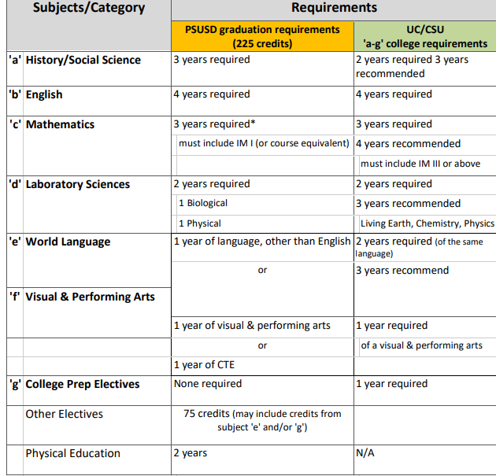
Graduation requirements
PSUSD Graduation Requirement
225 Total
1.51 Minimum GPA
Pass IM I or equivalent
Minimum Credits at the end of 10th Grade Year – 105 Credits

Slide 4
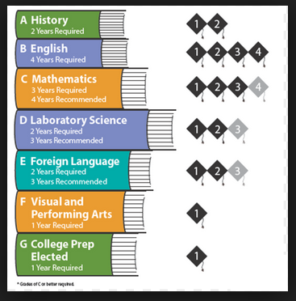
UC/CSU “a-g” requirements
All “D’s” must be repeated entering your senior year for new grade to be calculated into the GPA for the UC/CSU’s.
All “D’s” must be made up to be “a-g” eligible for the UC/CSU’s

Slide 5
Options for Junior Year
  AVID (Advancement Via Individual Determination) Program. Application & Interview process
  VAPA (Visual Arts & Performing Arts ) Program
  Theater/Technical Pathway
  Student Management Team
  Journalism I & Yearbook Production

Slide 6

AVID Program
  This well-known program is available for students who seek support to learn more about college and career options in order to best prepare for post-secondary education and beyond. This program focuses on WICOR strategies, study habits, time management, organization, and college exploration. Students are able to visit college campuses and explore careers based on various degrees.
Student must complete an AVID application online @ ranchomiragehighschool.org/course-request-information.
Applicants will be invited to an interview conducted by the AVID team
Applicants will be notified if they were accepted by the AVID team
AVID application deadline is Friday, February 24, 2023

Slide 7

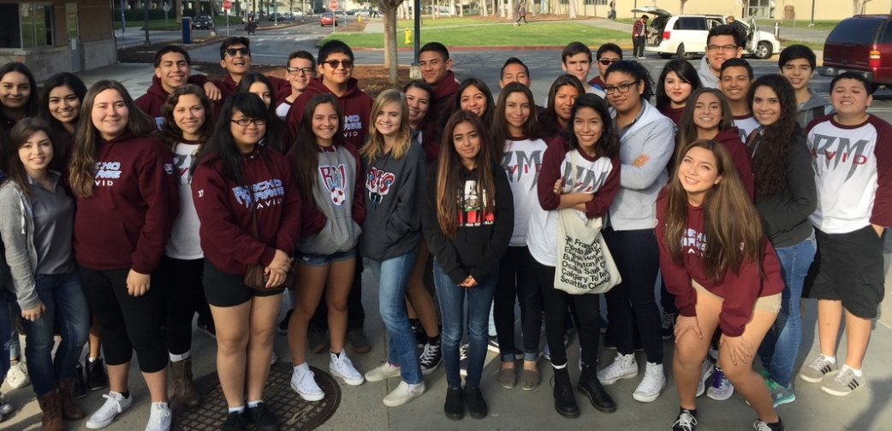

avidrmhs.weebly.com

Slide 8

Options for Junior Year
College of the Desert Concurrent Enrollment
What is Concurrent Enrollment?
  The concurrent enrollment program provides an opportunity for high school students to earn college credits at College of the Desert (COD) before they complete their high school diploma.
What is the criteria to apply for the concurrent enrollment?
  Be enrolled in high school between grades 9-12.
  Have a cumulative GPA of 3.0 or higher (If your GPA is below 3.0, a letter of recommendation from a teacher or counselor is required).

Slide 9
College of the Desert
What are the charges for concurrent enrollment?
Tuition and fees are complimentary, meaning tuition and fees are free to high school students. High school students only need to purchase books, supplies, and a parking permit, if needed.
  How do I sign-up for courses?
Concurrent Enrollment Complete Checklist
Review the class schedule with your high school counselor and choose a course
  Student can take up to 11 credits (fall and spring), 6 credits (summer), or 1 course (winter)
  All courses must be approved by the college
  Remember, for every one hour of lecture or lab, two hours of homework will be expected

Slide 10
Visual Arts & Performing Arts
These programs have been created to showcase the multiple disciplines of visual art, dance, theater, choir and instrumental music. RMHS will welcome students from across the district, that are interested in these art forms. The performing arts center features a 600-seat theater, rooms for scene and costume design, orchestra pit, black box theater, band and choir rooms. Students will have the opportunity to explore their area of interest, as well as participate in synchronized musical theater productions. These programs include a sequence of Visual and Performing Arts (VAPA) courses combined with a rigorous course of study in the core academic areas.

Slide 11
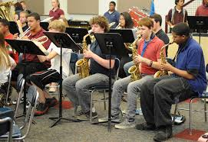
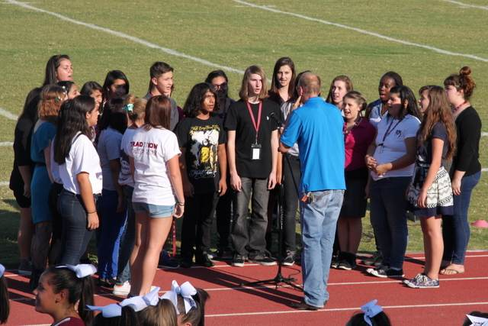
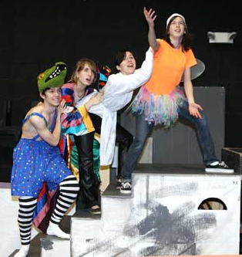
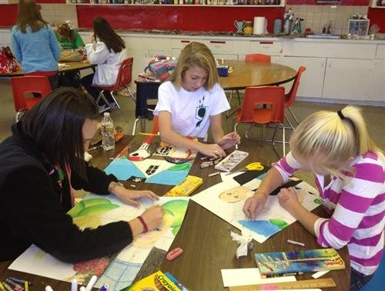
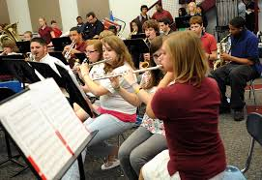
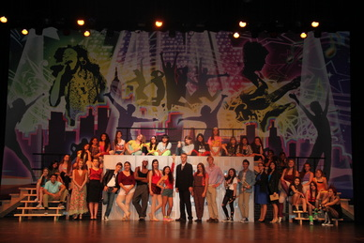
Visual / Performing Arts
Band
Choir
Dance
Theater
Art

Slide 12
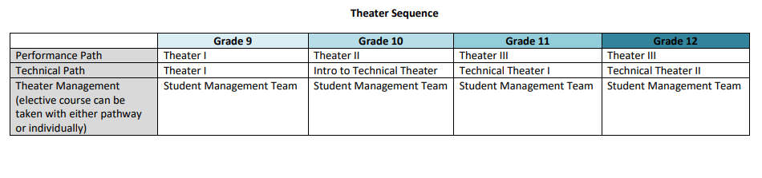
Theater/Technical Pathway
  This newer pathway focuses on the variety of technical fields in the performing arts such as stagecraft, lighting, sound, costume design, set design, and business management. These lucrative jobs are in high demand in California, and RMHS is poised to prepare students to successfully enter this job market. Students are able to take a sequence of CTE courses combined with a rigorous course of study in the core academic areas.

Slide 13
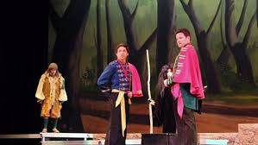
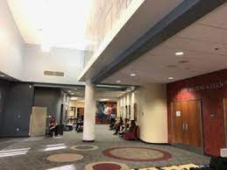
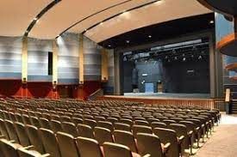
Student Management Team
Separate from the Technical Theater Pathway sequence is the new Student Management Team course (SMT). Students are able to learn about the box office, business management, and marketing. Ticket sales, advertising, and ushering are some key components to running the Helene Galen Performing Arts Center (HGPAC) where students are able to gain practical, hands-on knowledge of managing a theater.

Slide 14
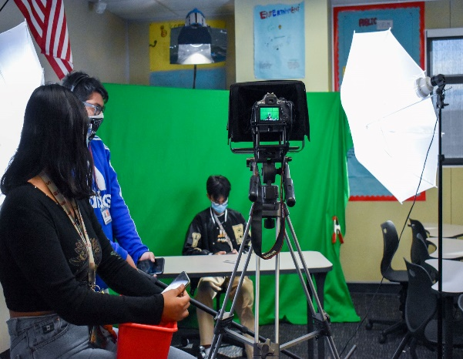
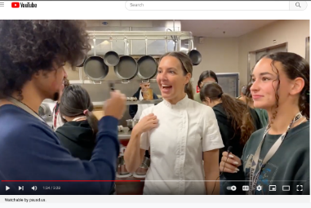
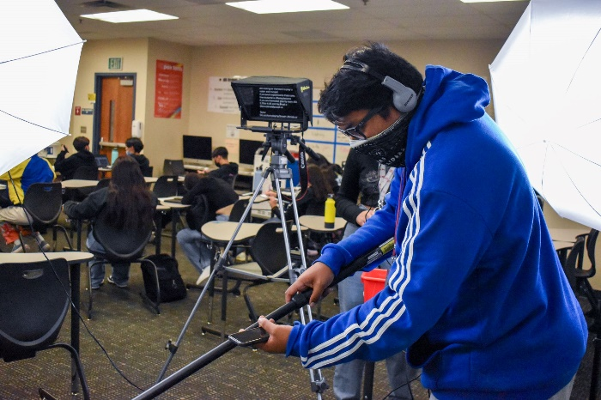
JOURNALISM I
Introduction to Digital Storytelling
Learn Video & Film Production
Prepare segments for the Rattler Report broadcast
Explore Podcasting, Filmmaking, Digital Animation
Work in Adobe Premiere Pro, Animator, Illustrator, & After Effects
Enter Short Film contests
(most similar to DATA at CCHS or FILM at PSHS)

Slide 15
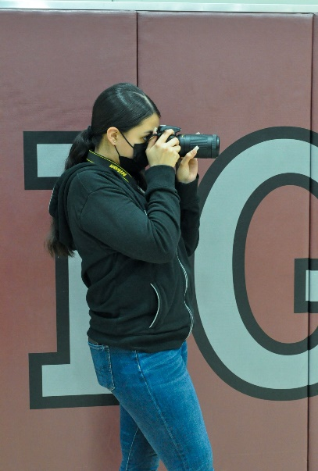
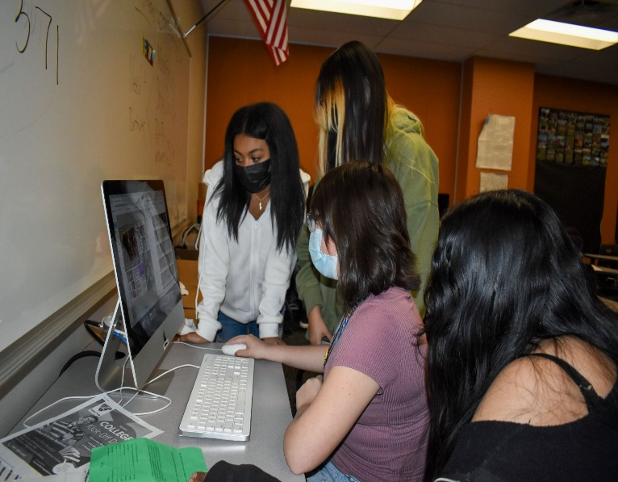
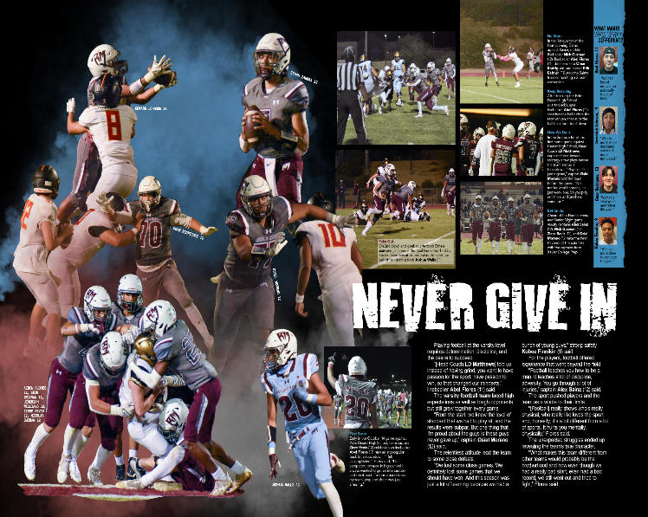
YEARBOOK PRODUCTION
Document RMHS’ History
Produce the yearbook for 2023-24
Learn Photography skills: journalistic and artistic
Learn graphic design skills
Have your writing PUBLISHED: tell the stories people will read forever
Work in Adobe Photoshop and Lightroom
Enter national contests to win awards for your work

Slide 17
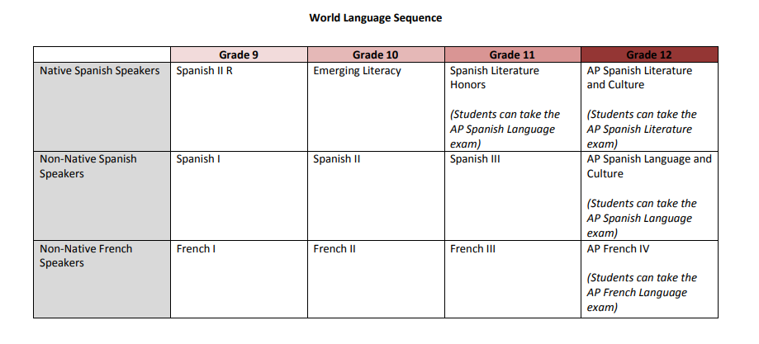
World Lang Sequence – Native/Non

Slide 18
Ca State Seal of biliteracy
English criteria includes:
Completion of all English language arts requirements for graduation with an overall grade point average of 2.0 or above.
Passing the California Standards (CAASPP) test in English language arts administered in grade 11th at the proficient level or above.
For English learners not reclassified, attain the overall early advanced level on the English language development test.

Slide 19
Ca State Seal of biliteracy
The criteria for proficiency in a language other than English is one of the following:
Passing a World Language Advanced Placement (AP) exam with a score of 3 or higher
Successful completion of a 4-yr high school course of study in a world language and attaining an overall grade point average of 3.0 or above.

Slide 20
Retake or recover a class
Edgenuity (online) classes during the school day or zero period. zero period class attendance is mandatory, M, T, Th & F (Media Center). Priority given to seniors who need the credits for graduation.
Students who enroll in the zero period Edgenuity class must complete the course within the quarter (Q1, Q2, Q3 & Q4). Letter grade will be given.
Attend summer school at RMHS or seek other options like Mirus Charter School (Online classes), etc.
Mission Graduate program – Online courses through Edgenuity. Student must qualify for the program (Newcomers, EL’s, & Foster Youth).

Slide 21
AP/Honors Contract
I will:
Remain in the AP/Honors course that I have requested for the entire school year.
Take the AP Exam (if applicable) in the spring of 2024
Maintain high ethical standards concerning academic involvement, growth, and development.
Complete all assigned reading, homework, labs, research projects – including any summer homework. (Low grades will NOT be considered a reason for removal from AP/Honors courses, so commitment and progress for all students is the expected standard).

Slide 22
AP/Honors Contract
con’t
Maintain regular class attendance.
Speak with your AP/Honors teacher(s) regarding any problems or concerns you have regarding your success. OWN IT RATTLERS…!!!

Slide 23
Class of 2025 Course Registration
Class of 2025 course registration will take place through Social Studies classes on the following dates.
Thursday, February 9, 2023 (Auxiliary Gym) or
Monday, February 13, 2023 (Auxiliary Gym)
You will submit:
  Completed Course Selection form signed by a parent/guardian
You will receive:
  Transcript
  Summer school information

Slide 24
RMHS Counseling Dept WEbsite
Rancho Mirage High School
www.ranchomiragehighschool.org
Counseling – Course Request Information
http://www.ranchomiragehighschool.org/course-request-information.html
Rancho Mirage High School 2022-22 Course Catalog
http://www.ranchomiragehighschool.org/uploads/1/3/7/6/13760749/rmhs_course_catalog_22-23.pdf

Slide 25
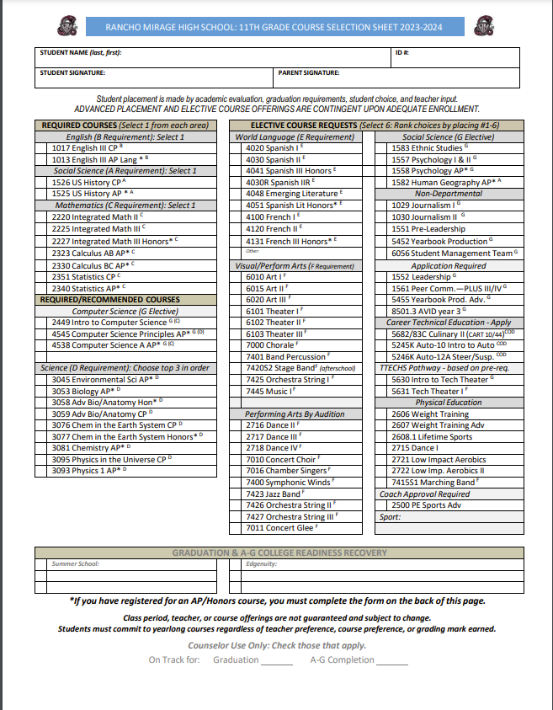

Slide 26
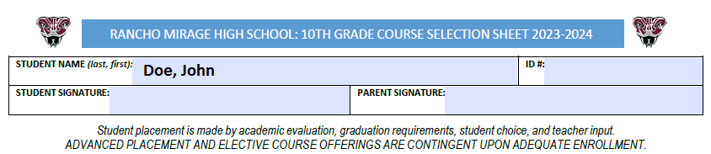

Slide 27
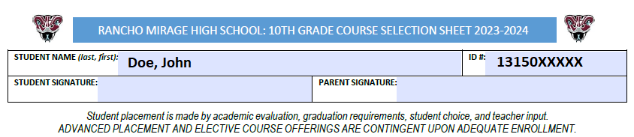

Slide 28
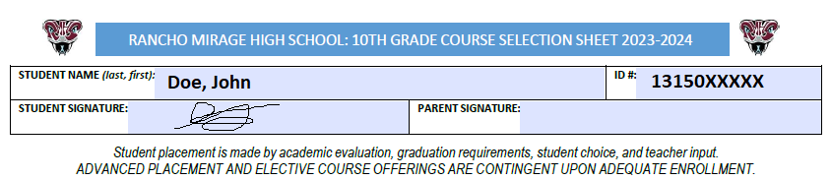

Slide 29
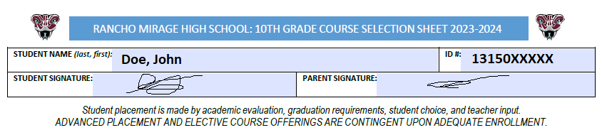

Slide 30
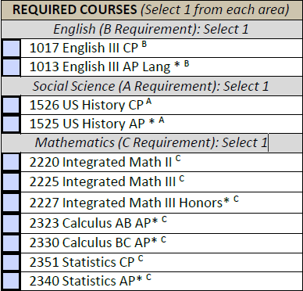

Slide 31
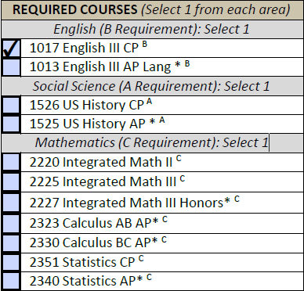

Slide 32
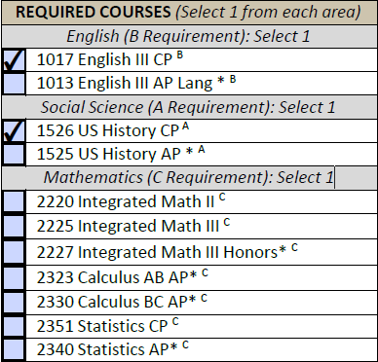

Slide 33
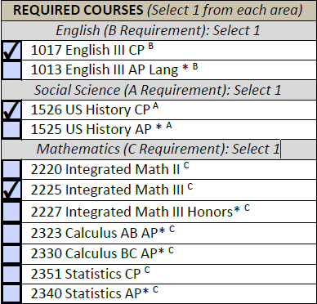

Slide 34
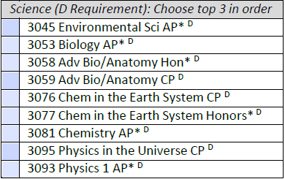

Slide 35
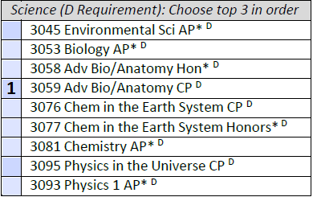

Slide 36
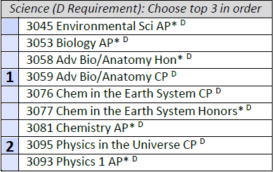

Slide 37
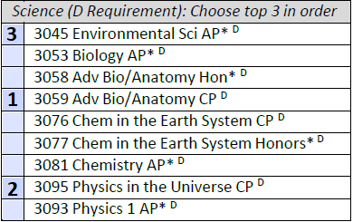

Slide 38
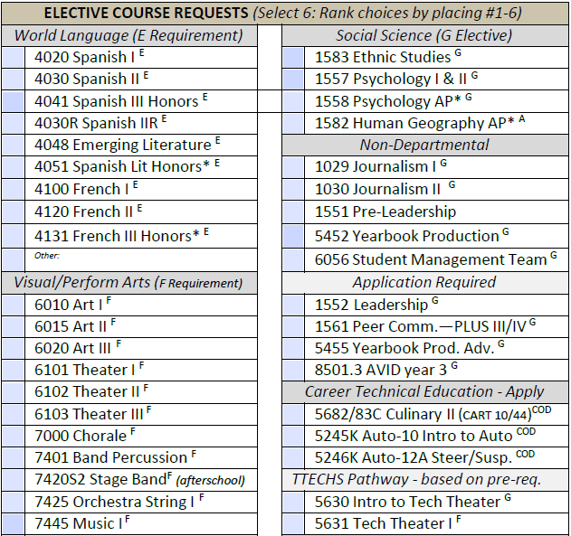
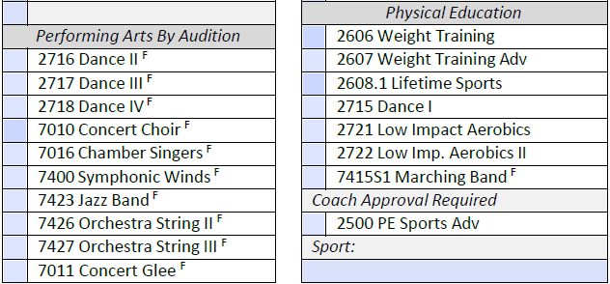

Slide 39


Slide 40


Slide 41
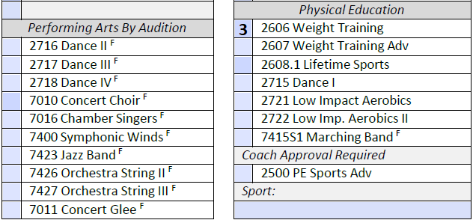

Slide 42


Slide 43
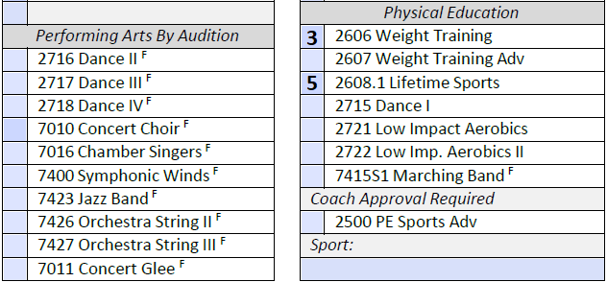

Slide 44


Slide 45
