Slide 1
2024-25 Course Selection Presentation

Slide 2
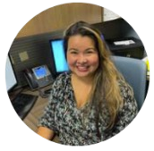
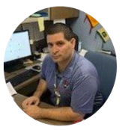
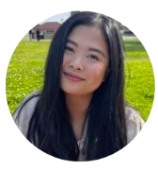
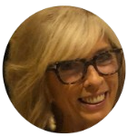
RMHS COUNSELING DEPARTMENT
Mrs. Garcia
DiB - Long
RACE Academy, TTECHS,
Advanced Theater, SMART Program
9th Grade Special Education
Mr. Solis
Ramos - Z
CAFE Academy
11th Grade Special Education
Ms. Huynh
A - Diaz Santiago
AVID Program
12th Grade Special Education
Ms. Watson
Lopez - Ramirez
Advanced Performing Arts
10th Grade Special Education

Slide 3
GRADUATION REQUIREMENTS
PSUSD Graduation Requirement
225 Total
1.51 Minimum GPA
Pass IM I or equivalent
Minimum Credits at the end of 9th Grade Year – 45 Credits
1 class = 10 credits per year
Or 5 credits per semester.
Students take 6 class and can earn 60 credits in one year.

Slide 4
A-G Requirements
class | Subject | Years | Credits
A | History | 2 years | 20
B | English | 4 years | 40
C | Math | 3⁺ years | 30
D | Science (Life & Physical) | 2⁺ years | 20
E | Language other than English | 2⁺ years | 20
F | Visual/Performing Arts | 1⁺ year | 10
G | College Prep Elective | 1 year | 10
All grades must be a C or better! |  |  | 150 credits
HS Graduation credit requirement
History: 30
English: 40
Math: 30
Science 20
LOTE: 10 or
VAPA: 10
PE: 20
Electives: 75 credits
225 credits

Slide 5
Questions on
HS Graduation or A-G?

Slide 6
OPTIONS FOR SOPHOMORE YEAR
VAPA (Visual Arts & Performing Arts ) Program
Student Management Team
Journalism I & Yearbook Production
Computer Sciences (Intro & AP)

Slide 7
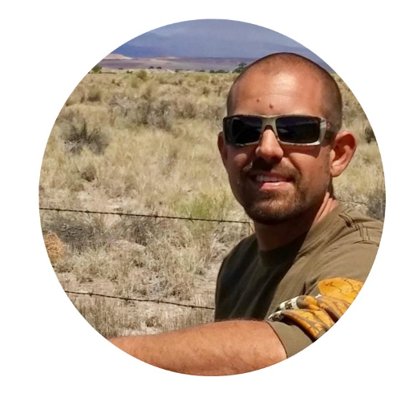
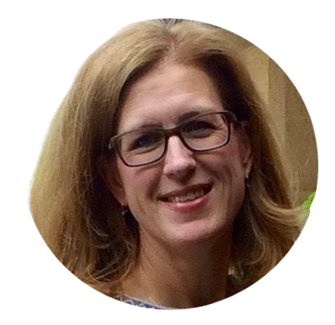
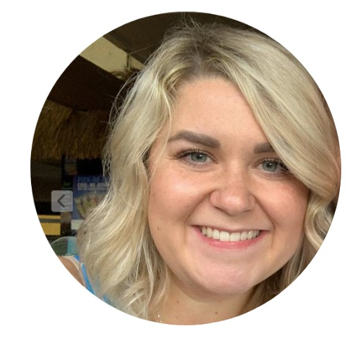
Rancho Mirage High School Academies
TTECHS
Technical Theater Education & Careers for High School Students
AVID
Advance via Individual Determination
CAFE
Culinary Arts Food Education
RACE
Rattler Automotive Careers Education
Chef Van Loon
10-12 grade
Mr. Bodnar
10-12 grade
Mrs. Newhouse
9-12 grade
Mrs. Robinson
Mrs. Sandoval
9-12 grade

Slide 8
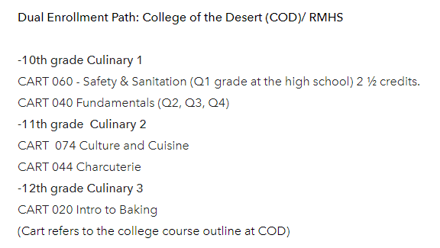
CAFE: https://cafeacademy.weebly.com/
Instructor: Chef Jenna Van Loon | Counselor: Mr. Solis
3 year program through COD (10th-12th)
The RMHS Culinary Arts For Education (CAFE) program is a professional learning environment designed to foster full student potential through rigorous and relevant academics and work-based experience in order to empower, inspire, and prepare our students for post-graduate college or career paths in the hospitality industry.

Slide 9
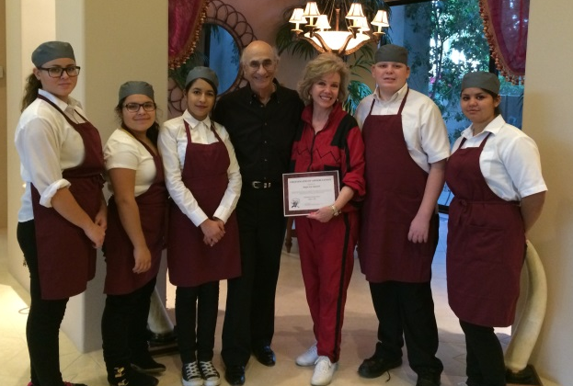
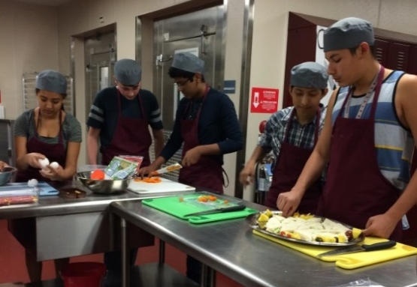
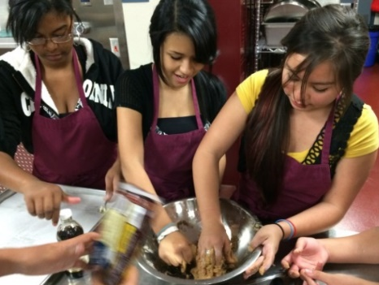
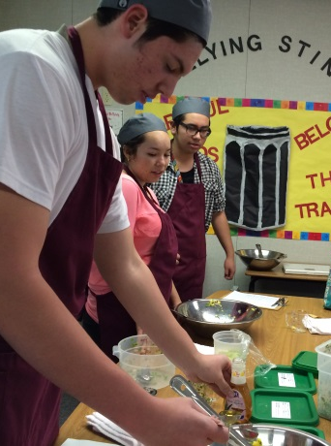
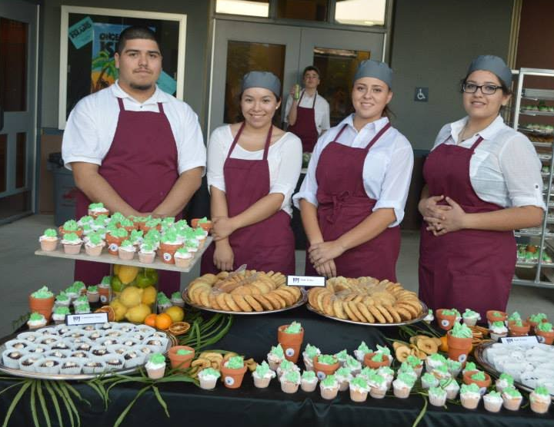
CAFE ACADEMY

Slide 10
RACE: https://rmhsraceacademy.weebly.com/
Instructor: Will Bodnar | Counselor: Mrs. Garcia
3 year program through COD ( 10th-12th)
Automotive 010
This course covers the fundamentals and basic knowledge of the automotive repair trade. It includes shop safety, hand tools, fasteners, shop math, and an overview of basic automotive systems.
Automotive 012
This course provides theory and hands-on experience in automotive steering and suspension systems including: theory of operation, service, diagnosis and repair.
Automotive 013
This course covers the basic fundamentals and basic knowledge of the automotive repair trade for the braking system. It includes discussion, demonstrations and hands-on laboratory practice, shop safety, hand tools, hydraulic principles, shop math, brake system principles, system diagnosis and repair, basic electrical, wiring schematics and electrical diagnosis.
The RMHS Rattler Automotive Careers Education (RACE) program is a professional learning environment designed to foster full student potential through rigorous and relevant academics and work-based experience in order to empower, inspire, and prepare our students for post-graduate college or career paths in the automotive industry.

Slide 11
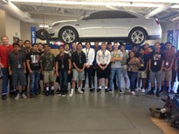
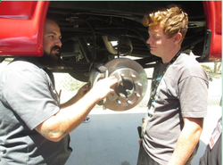
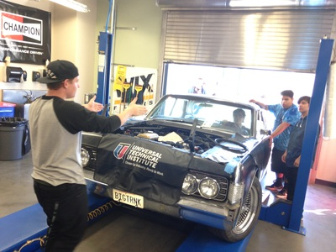
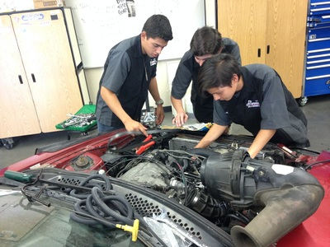
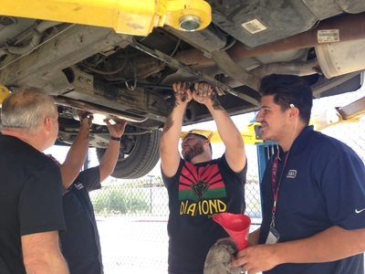
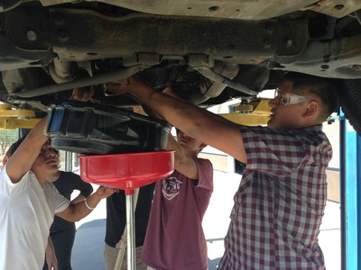
RACE ACADEMY

Slide 12
TTECHS: https://rmhstheaterclasses.weebly.com/
Instructors: Mrs. Newhouse | Counselor: Mrs. Garcia
Students can participate in grades 9-12
The TTECHS Career Pathway at Rancho Mirage High School gives students an opportunity to learn about technical theatre/entertainment industry while providing real life-skills needed to enter college or employment in the industry. Interacting with the community through production support, field trips, and mentors allows TTECHS students to develop both technical and employability skills needed to succeed in the field.
What are some things I can learn in TTECHS?
The TTECHS Pathway offers students both academic and professional skills that apply to subjects such as mathematics and physics. The curriculum features a hybrid of solid academics and professional training to provide hands-on experience in the tech theatre/entertainment industry.
Students are expected to master basic construction and measurement skills while utilizing basic hand tools, power tools, and other equipment to complete required stage tasks.

Slide 13
THEATER/TECHNICAL PATHWAY
This newer pathway focuses on the variety of technical fields in the performing arts such as stagecraft, lighting, sound, costume design, set design, and business management. These lucrative jobs are in high demand in California, and RMHS is poised to prepare students to successfully enter this job market. Students can take a sequence of CTE courses combined with a rigorous course of study in the core academic areas.

Slide 14
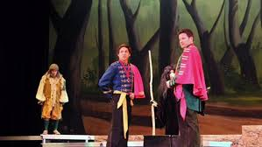
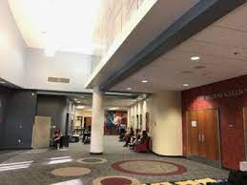
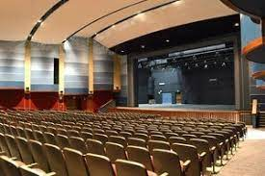
STUDENT MANAGEMENT TEAM
Separate from the Technical Theater Pathway sequence is the new Student Management Team course (SMT). Students are able to learn about the box office, business management, and marketing. Ticket sales, advertising, and ushering are some key components to running the Helene Galen Performing Arts Center (HGPAC) where students are able to gain practical, hands-on knowledge of managing a theater.

Slide 15
AVID: http://avidrmhs.weebly.com/
Instructors: Mrs. Robinson, Mrs. Sandoval
Counselor: Ms. Huynh
Student must complete an AVID application online @ ranchomiragehighschool.org/course-request-information.
Applicants will be invited to an interview conducted by the AVID team
Applicants will be notified if they were accepted by the AVID team
AVID application due by Friday, February 16th
AVID, Advancement via Individual Determination, is a national program that works to help motivated students become college and career ready. This program, which is an elective class taken each year during high school, focuses on building student's skills in writing, inquiry, collaboration, organization, and reading through a challenging curriculum and activities. Students are expected to take challenging courses, work together with their classmates and AVID family, and participate in volunteer work and extracurricular activities.

Slide 16
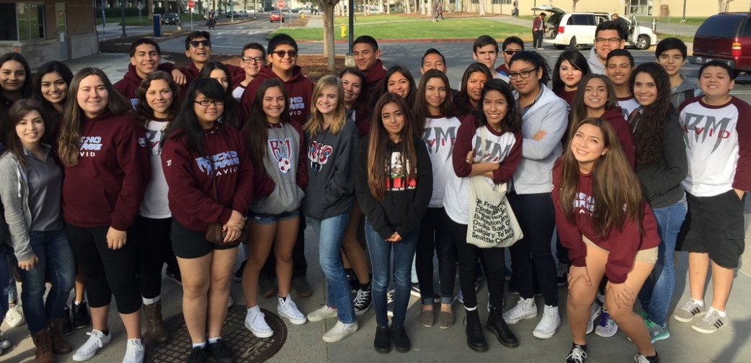
avidrmhs.weebly.com

Slide 17
OPTIONS FOR SOPHOMORE YEAR
College of the Desert Concurrent Enrollment
What is Concurrent Enrollment?
The concurrent enrollment program provides an opportunity for high school students to earn college credits at College of the Desert (COD) before completing their high school diploma.
Concurrent enrollment are classes taken outside of the regular school day
What is the criteria to apply for the concurrent enrollment?
Must be enrolled in high school
Must have a cumulative GPA of 3.0 or higher (If your GPA is below 3.0, a letter of recommendation from a teacher or counselor is required).

Slide 18
COLLEGE OF THE DESERT
What are the charges for concurrent enrollment?
Tuition and fees are free to high school students. High school students only need to purchase books, supplies, and a parking permit, if needed.
How do I sign-up for courses?
Concurrent Enrollment Complete Checklist
Review the class schedule with your high school counselor and select a course.
Student can take up to 11 credits (fall and spring), 6 credits (summer), or 1 course (winter).
All courses must be approved by the college.
Remember, for every one hour of lecture or lab, two hours of homework will be expected.
Before starting concurrent enrollment,
please contact your counselor FIRST!
Notes:
https://www.collegeofthedesert.edu/students/admissions/high-school.php

Slide 19
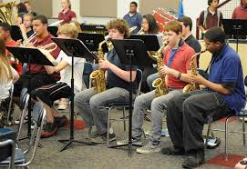
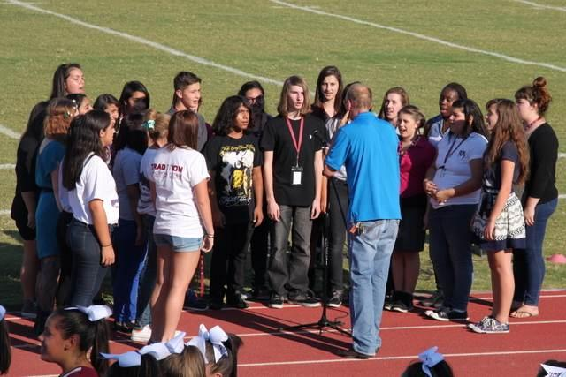
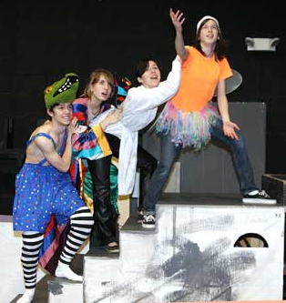
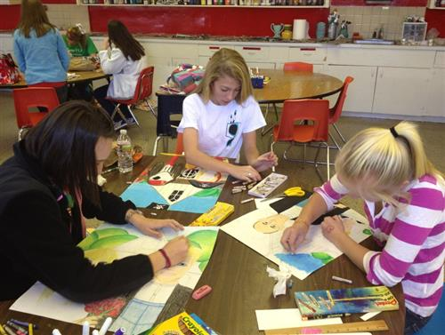
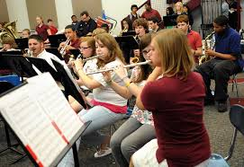
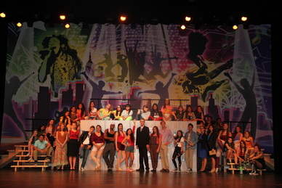
VISUAL / PERFORMING ARTS
Band
Choir
Yearbook
Dance
Theater
Art

Slide 20
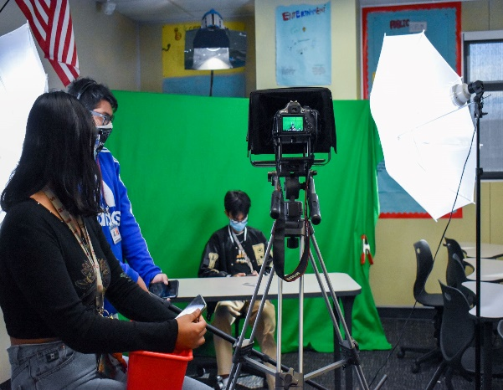
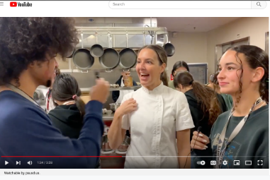
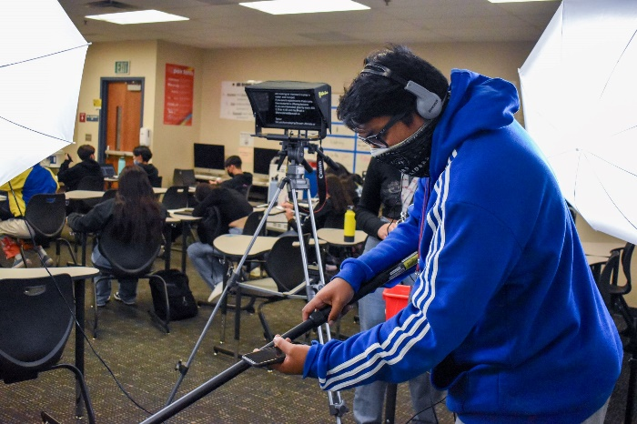
JOURNALISM I
Introduction to Digital Storytelling
Learn Video & Film Production
Prepare segments for the Rattler Report broadcast
Explore Podcasting, Filmmaking, Digital Animation
Work in Adobe Premiere Pro, Animator, Illustrator, & After Effects
Enter Short Film contests
(most similar to DATA at CCHS or FILM at PSHS)

Slide 21
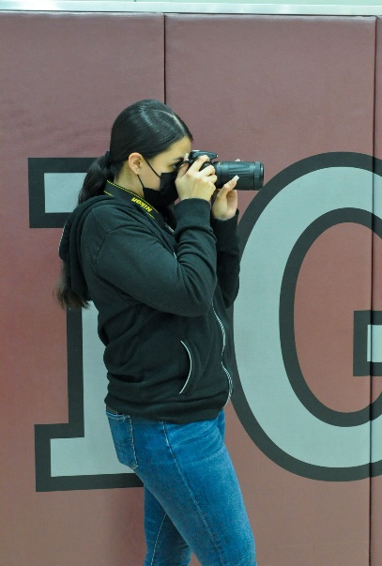
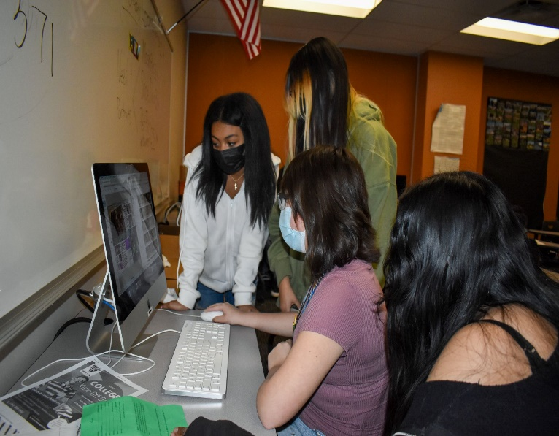
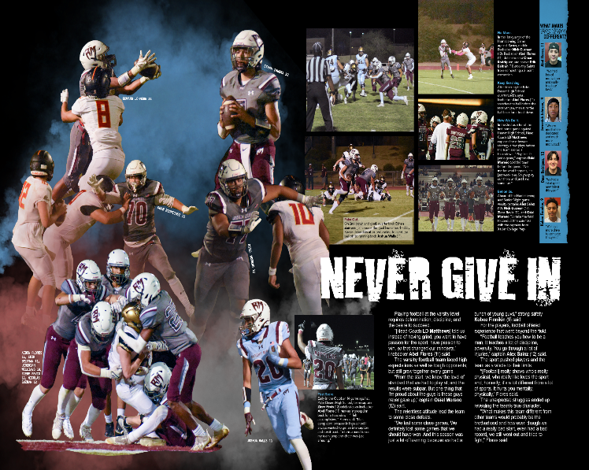
YEARBOOK PRODUCTION
Document RMHS’ History
Produce the yearbook for 2024-25
Learn Photography skills: journalistic and artistic
Learn graphic design skills
Have your writing PUBLISHED: tell the stories people will read forever
Work in Adobe Photoshop and Lightroom
Enter national contests to win awards for your work

Slide 22
RMHS COMPUTER SCIENCE CHOICES
Rancho Mirage High School offers three computer science courses:
Introduction to Computer Science (G & C)
AP Computer Science Principles (G & D)
AP Computer Science A (G & C)
This is the "natural order" of these three classes, but they do not need to be taken in this order, and it is possible to skip one or more.
Details…

Slide 23
EXISTING COURSES
COMPUTER SCIENCE A - ADVANCED PLACEMENT
Length of Course: 1 Year
Grades: 11-12 Prerequisites: IM I recommended
Credits: 10
Type: Elective (G & C)
AP Computer Science A is an introductory college-level computer science course. Students cultivate their understanding of coding through analyzing, writing, and testing code as they explore concepts like modularity, variables, and control structures.

Slide 24
EXISTING COURSES
COMPUTER SCIENCE PRINCIPLES - ADVANCED PLACEMENT
Length of Course: 1 Year
Grades: 10-12
Prerequisites: Integrated Math I recommended
Credits: 10
Type: Elective (G & D)
AP Computer Science Principles is an introductory college-level computing course that introduces students to the breadth of the field of computer science. Students learn to design and evaluate solutions and apply computer science to solve problems through the development of algorithms and programs. They incorporate abstraction into programs and use data to discover new knowledge. Students also explain how computing innovations and computing systems—including the internetwork, explore their potential impacts and contribute to a computing culture that is collaborative and ethical.

Slide 25
EXISTING COURSES
Human Geography - ADVANCED PLACEMENT
Length of Course: 1 Year
Grades: 9-12
Prerequisites: None
Credits: 10
Type: Elective (A & G)
AP Human Geography is an introductory college-level human geography course. Students cultivate their understanding of human geography through data and geographic analyses as they explore topics like patterns and spatial organization, human impacts and interactions with their environment, and spatial processes and societal change.

Slide 26
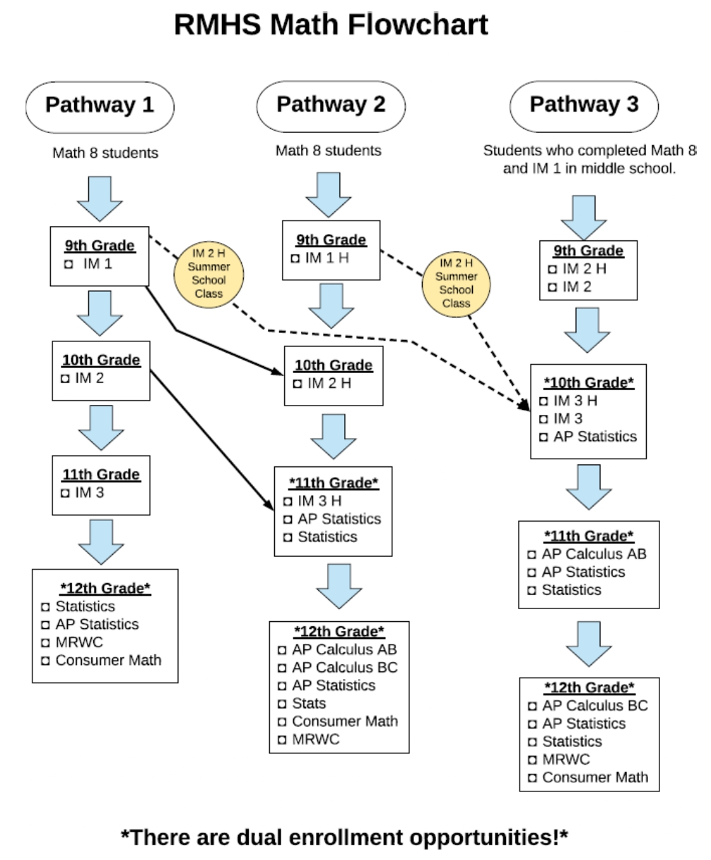

Slide 27
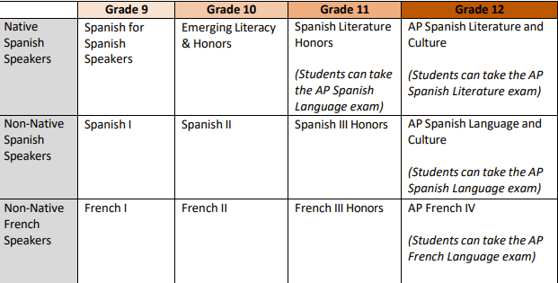
WORLD LANG SEQUENCE – NATIVE/NON-NATIVE

Slide 28
CA STATE SEAL OF BILITERACY
In order to fulfill the CA State Seal of Biliteracy you must meet the
English criteria & demonstrate proficiency in another language other than English.

Slide 29
CA STATE SEAL OF BILITERACY
Meeting the English criteria includes:
Completion of all FOUR years of English language arts requirements for graduation with an overall grade point average of 3.0 or above.
OR
Passing the California Standards test (CAASPP) in English language arts administered in grade 11th at the proficient level or above.
Pass an Engl. AP examination w/a score of 3 or higher (AP Lang. or AP Lit.)
English language learners who have not been reclassified, must attain the overall “early advanced level” on the English language development test (ELPAC).

Slide 30
CA STATE SEAL OF BILITERACY
Meeting the criteria for proficiency in a language other than English requires one of the following:
Successful completion of a 4-yr high school course of study in a world language (LOTE) and attaining an overall grade point average of 3.0 or above.
OR
Passing a World Language Advanced Placement (AP) exam with a score of 3 or higher.
AP Span. Lit. IV
AP Span. Lang. IV
AP French IV

Slide 31
AP/HONORS CONTRACT
I will:
Remain in the AP/Honors course that I have requested for the entire school year.
Take the AP Exam (if applicable) in the spring of 2025
Maintain high ethical standards concerning academic involvement, growth, and development.
Complete all assigned reading, homework, labs, research projects – including any summer homework.

Slide 32
AP/HONORS CONTRACT
Maintain regular class attendance.
(Low grades will NOT be considered a reason for removal from AP/Honors courses, so commitment and progress for all students is the expected standard).
Speak with your AP/Honors teacher(s) regarding any problems or concerns you have regarding your success. OWN IT RATTLERS…!!!

Slide 33
HOW TO RETAKE OR RECOVER A GRADE
Edgenuity (online) classes are available during the school day as well as during 0 period. Zero period class attendance is mandatory M, T, Th & F (Media Center). Priority is given to those seniors needing the credits for graduation.
Students enrolling in the 0 period Edgenuity class must complete the course within the quarter (Q1, Q2, Q3 & Q4). A letter grade will be given.
Attend summer school at RMHS or seek other options, for example, Mirus Charter School (Online classes), etc.

Slide 34
CLASS OF 2027 COURSE REGISTRATION
Class of 2027 course registration will take place through PE, Dance, & Band class on the following dates.
Tuesday, February 20, 2024 (Auxiliary Gym) or
Thursday, February 22, 2024 (Auxiliary Gym)
Copy of your high school transcript will be provided to you along with other important information.

Slide 35
RMHS COUNSELING DEPT WEBSITE
Rancho Mirage High School
www.rmhs.us
Counseling – Course Request Information
https://www.rmhs.us/course-request-information1.html
Rancho Mirage High School 2024-25 Course Catalog
https://www.rmhs.us/uploads/1/4/5/4/145415380/rmhs_course_catalog_24-25.pdf

Slide 36
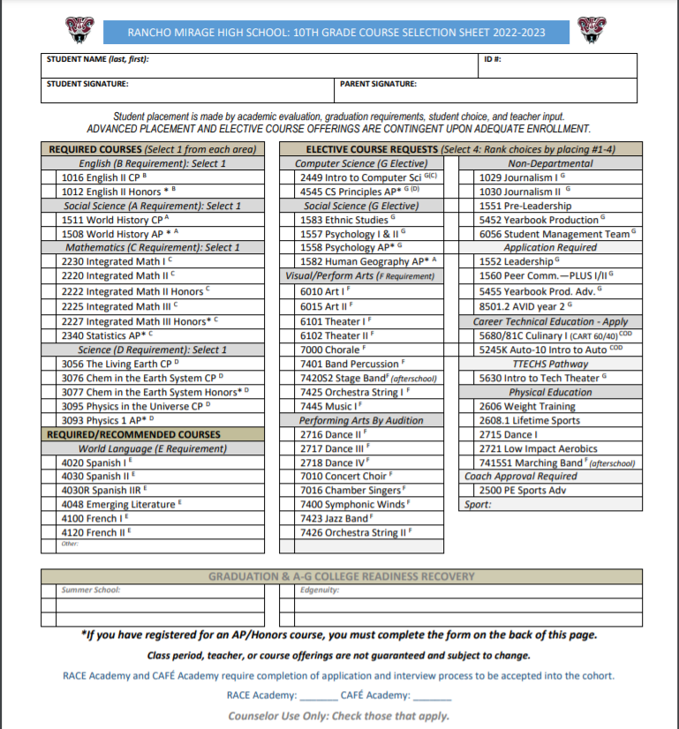

Slide 41
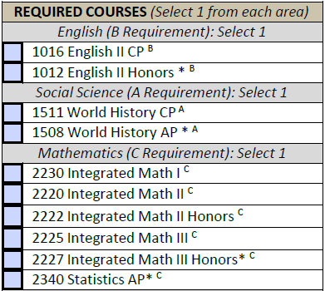

Slide 42
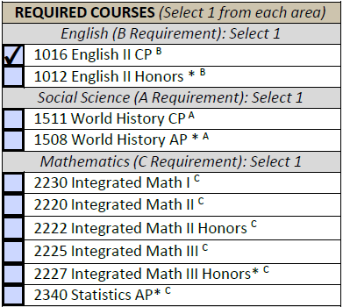

Slide 43
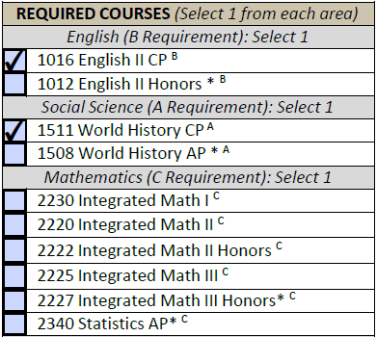

Slide 44
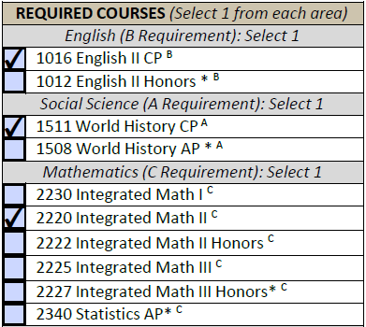

Slide 49
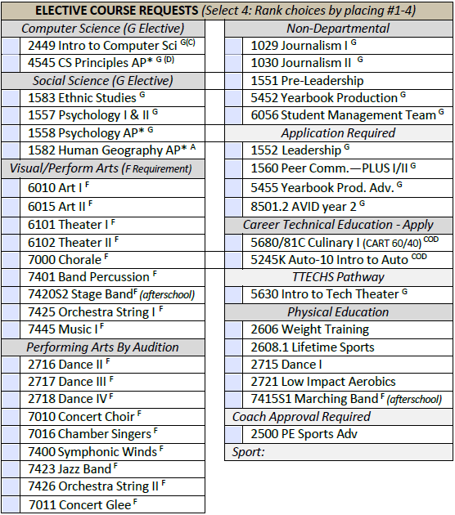
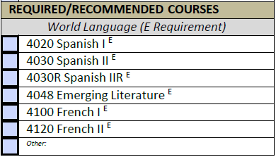

Slide 50
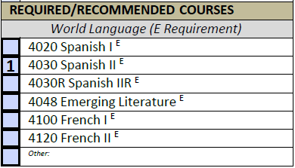

Slide 54
